Slide 1
Our experience aligned with your needs
Proposal to serve Cigna Corporate Services, LLC
CIP Strategy Execution
March 16, 2023
—
kpmg.com

Slide 2
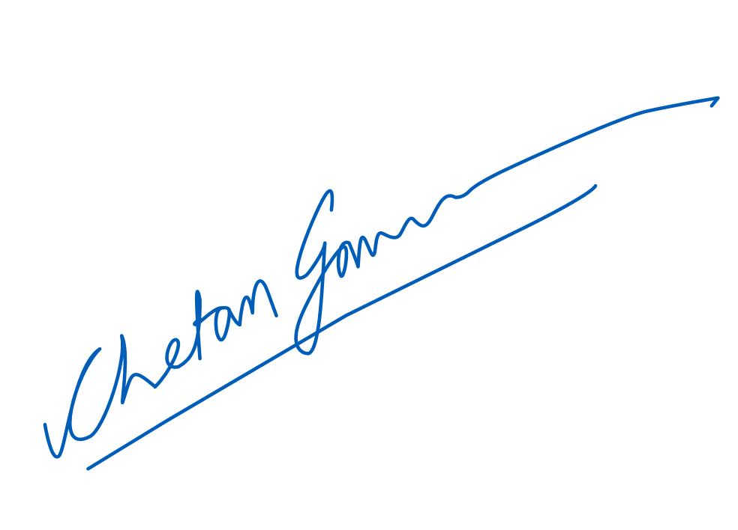


March 16, 2023
Kellie Hays
Cigna Global Procurement
Cigna Corporate Services
Dear Kellie,
Cigna has completed its security strategy refresh and is seeking a technical partner to execute its CIP strategy. KPMG LLP (KPMG) is uniquely positioned to improve upon the robust organizational foundation that Cigna has built and deliver a strategy transformation uniquely tailored to Cigna’s needs. KPMG has the experience, technical know-how, and industry leading qualifications to deliver this security transformation program. By working with KPMG, Cigna will benefit from the following:
Cigna and KPMG share a long-standing, valued relationship. KPMG has consistently over-delivered value to Cigna on some of the organization’s most important and strategic initiatives, including Project Dawn Transformation, Finance and Accounting Services, Finance Cloud Enablement, and Client Service Transformation among various others.
KPMG is experienced in delivering Security Transformation Projects. KPMG has developed a Target Operating Model framework that considers business strategy, technology strategy, and security capabilities for similar projects. We have delivered similar work at leading financial services, professional services, healthcare, and technology companies. In this proposal we have presented insights based on our experience delivering similar projects. An effective execution of target operating model means bringing capabilities together under a managed program with an agile delivery approach to solve for talent, process, and technology.
KPMG is the leader in integrated Cyber Security and Transformation Delivery Services. KPMG was named by Forrester Research as a leader in their most recent Forrester Wave™: Global Cyber Security Consulting Providers report. KPMG received the highest possible scores in business acumen; security strategy consulting capabilities; and governance, risk and compliance capabilities. KPMG was praised for “…helping security leaders understand the next crisis, not just the current one”. Furthermore, KPMG has a dedicated transformation delivery practice with a focus on portfolio management, change management, and agile transformation. We help our clients prioritize and govern their transformation portfolios more effectively, including the introduction of new ways of work like Agile to drive business outcomes more efficiently. Effectively our cyber and transformation team will deliver an integrated solution to you. We will bring a combined team of cyber transformation professionals, program management professionals, current KPMG professionals supporting Cigna to deliver an integrated solution
We are confident that this proposal emphasizes how important your business is to our engagement team and our firm, and how eager we are to build a long-standing professional relationship with Cigna. Please do not hesitate to call us with any questions.
Very truly yours,
KPMG LLP
Anurag Rai Cyber Lead Partner 312-665-2563 anuragrai@kpmg.com | Chetan Gavankar Engagement Partner - Cyber 617-650-3010 cgavankar@kpmg.com | Daniel Guistolise Engagement Partner – PMO and Agile 773-294-1644 dguistolise@kpmg.com

Slide 3
Contents
Section | #
Executive summary | 4
Detailed approach and timeline | 9
Team and pricing | 17
Appendices | 20
Appendix A: KPMG’s trusted relationship with Cigna | 21
Appendix B: PMO (Workstream 3) | 24
Appendix C: Agile (Workstream 4) | 32
Appendix D: Organization Design (Workstream 6) and Change Management (Workstream 7) | 36
Appendix E: KPMG Ignition Center | 42
Appendix F: Cyber Risk Quantification and Insights | 45
Appendix G: Target Operating Model Framework | 51
Appendix H: Team résumé | 54
Restriction on Disclosure and Use of Data – This document contains confidential or proprietary information of KPMG LLP, the disclosure of which would provide a competitive advantage to others; therefore, the recipient shall not disclose, use, or duplicate this document, in whole or in part, for any purpose other than recipient's consideration of KPMG LLP's proposal.

Slide 4
Executive summary

Slide 5
Our understanding of your strategic requirements
Cigna is looking to engage with a technical consulting firm to enhance Cyber Security maturity across multiple workstreams. The key objective is to assist Cigna with execution of its cyber roadmap that resulted from a strategy refresh.
Governance
And Organization Structure
aligned to CIP mission to keep data secure and available while enabling speed, scale, and trust
with clear roles and responsibilities to deliver CIP services
with defined Interaction model with business and IT
Example security domains for CIP’s strategy execution
Cigna continues to disrupt the market as the purpose-driven global health services company
to build a risk aligned project portfolio to deliver business and CIP strategy
to make CIGNA’s cybersecurity posture a differentiator for clients and customers
Agile Transformation
Strategy
Program Management
KPMG will work with CIGNA leadership to design a roadmap for a future ready security organization
Governance, Risk, and Compliance
Policy and Standards
Data Gathering:
Analysis:
BISO Program Define and operationalize a vision into missions and objectives
Strategy- and governance documentation
Change management
Build a roadmap and execute on objectives in each workstream
Metrics and Reporting
Awareness
BISO vision
Modernize security org. structure
Assess current CIP org. structure and recommend improvements and roadmap for transition to new structure
Business Goals
Current Organization
Agile Acceleration and Transition
Review agile end state goals, develop roadmap and develop agile training courses
Overview of PMO portfolio
Portfolio Management Office (PMO)
Review operating model, develop PMO templates and support program management
Agile Program and Change Management
Vulnerability Identification and Remediation
Technology Understanding
Organizational Governance
Establish clear roles & responsibilities to create effective decision- making framework with clear oversight to manage risk.
Security Risks
CIP Security Services
Security services catalog
Document current CIP security services, and design supporting templates incl. RACIs
Monitoring and Incident Response
Data Protection

Slide 6
KPMG’s insights on factors that drive security operating model transformations
KPMG has successfully delivered numerous projects similar in nature to what we are proposing to Cigna. From our experience we have developed a set of insights.
Insight |  | How KPMG addresses this
1 | Transformation Journey | Strategy and Solution Delivery Frame strategy, define value, design the journey by mobilizing the right programs to enable CIP vision Execute individual transformation program and products that deliver value on an iterative basis using the right way of working Orchestrating the Change and Value Realization Govern continuous planning and prioritization of the program and project portfolio, while monitoring and controlling execution and driving the needed change experience for your people Drive accountability and adoption to capture value from transformation programs
Organizations are recognizing transformation is becoming a continuous journey with evolving end points. This calls for stronger transformation portfolio capability that considers clear alignment of strategy to execution, sharp focus on value planning and measurement, rigorous program orchestration and controls.
2 | Business aligned security | Flexibility and Familiarity Adapt security model that is capable of growing with your business Build upon transformation work of Project Dawn to continue to foster scalable identity-centric measures to simplify access for employees and customers while maintaining robust security controls Define, Streamline, & Integrate Streamline and define processes for addressing security issues with clear outline of points of contact, recommended paths, and appropriate instances to utilize technology Develop and define communication paths related to affected security domains and assigned points of contact within CIP and affected business partner Organize and integrate regulatory, third-party, and internal business requests to a defined process to streamline communication efforts and promote efficiency, avoiding duplication of effort
Implement security in a way that can keep up with business growth, implement new technology and support of legacy technology
3 | Talent | Culture of Accountability and Targeted Skillsets Clearly defined responsibilities and interaction model help reduce job role scope creep to keep workloads at reasonable levels Foster a security culture throughout the organization to potentially reduce the number and frequency of security events and incidents Promote Efficiency Implement automation to augment employee capabilities and efficiency Right size teams with flex options to ensure that workloads are realistic to reduce talent turnover
Security skills are in demand and existing teams are overworked and overwhelmed, this requires an automated and agile approach

Slide 7
KPMG’s insights on factors that drive security operating model transformations (continued)
Insight |  | How KPMG addresses this
4 | Security Risk and Governance | Best Practice and Industry Standard Baselines Provide a repeatable view of risk using widely held and established methods for risk identification and treatment. Incorporate technology to continuously monitor and evaluate risk Personalized Governance Articulate and clearly define CIP team members, responsibilities, and areas of expertise Perform analysis for current roles across business units and map positions to established governance frameworks as baseline. Utilize past client experience to initiate next step in developing unique governance model for Cigna Information Protection and recommendations for relevant stakeholders in cybersecurity space (i.e. Identity, Digital, & Compliance). Create guidance for navigating Cigna’s technology landscape when responding to vulnerabilities, regulatory findings, or internal requests utilizing a defined-governance model and risk-based approach Identify which tools to use when and who should use them
Large organizations with big business divisions have historically been misaligned and require governance frameworks aligned to security requirements of tomorrow.
5 | Agile Transformation and Coaching | Agile Transformation Assessment and Roadmap Evaluation of current organization Agile capabilities, level of maturity, gaps to target Agile Operating Model end state, and roadmap to fill the key gaps. This roadmap then provides a prioritized and sequenced set of activities to mature Agile competency and capabilities, Agile Operating Model A framework for when and how to use Agile in planning and solution delivery. This includes models to consider Agile and Agile + Waterfall, clear roles for each scenario, how the business and IT need to partner, the needed Agile delivery tooling environment and standards, and how Agile based delivery will be governed. Customizing Agile training and simulations to advance the knowledge and experience of different roles and personas required in the Agile Operating Model Agile Value Based Funding New way of planning, funding, and measuring success to rethink how to invest and incrementally measure return on investment.
Proper implementation of Agile methods is crucial to taking advantage of its benefits. Education and empowerment is needed beyond IT to share the power of its techniques, teaming methods, and iterative validation of capability and value.
6 | Security modernization | Scalable, Documented, and Comprehensible Features Contains clear catalogue of security services that are well understood across the organization Processes that are flexible and easily adjustable based on both current security threat levels and business needs Focus on Risk and Efficiency Advocates a risk-driven approach to security, allowing for the ability to prioritize efforts with the most significant risk and the ability to adapt security measure as risk profiles evolve, all while reducing unnecessary costs and maximizing return on investment. Promotes self-service and automation to improve organizational efficiency, foster accountability and increase individual security compliance.
Tailor Operating Model to be risk-based flexible to evolving threats, business need technology transformations, and regulatory demands that require a modern security organization

Slide 8
Why KPMG?
We know Cigna
Experienced Team
Accelerators
KPMG was an active participant in the DAWN program Steering and Operating committees in 2021 and knows what it takes to execute a large body of work while working with leadership, key stakeholders, business, experience owners and customers.
Previous experience working on CIP initiatives (e.g., Kerberoasting & Service Account Remediation) familiarizes our team with CIP stakeholders, technologies, and processes.
KPMG has assisted in addressing various regulatory findings related to Global Identity and CIP organizations since 2019 – successfully addressing audit concerns and satisfying project objectives.
KPMG has developed a variety of tested tools and accelerators to help deliver similar transformation project within the same industry as Cigna. KPMG brought a lot of these to Cigna in 2021 across Okta (MFA enrollment, self service application onboarding), Saviynt (Application Onboarding Accelerator), Governance (Data validation toolkit) and CyberArk (Migration Utility) and will continue to deliver in 2023.
KPMG teams have excellent working relationships across the board and will be important factor to continue the momentum.
KPMG has deep experience in executing transformations for leading companies around the world and has strategic alliances with the technology players in this area.
KPMG has robust catalog of security offerings allowing us to leverage experts across several disciplines including Strategy and Governance, Technical Implementations, Cloud Security and Threat Management
We have change management capabilities which can augment, improve and replace the current change management setup at Cigna.
We understand how an end-to-end transformation has the potential to impact a number of areas in the organization. We have a deep understanding of how to prepare, communicate, execute and sustain the changes to make them successful.
Transformation Journey Toolkit
KPMG brings a fully integrated solution to enable the journey from strategy to value realization. This includes methods and enabling tools for portfolio management and governance, value management, and organization change management. To enable flexible and accelerated solution delivery, we enable new ways of working, with a focus on the right Agile operating model.
Security Organization Frameworks and Tools
Global Cyber TOM industry leading frameworks developed by KPMG security and Transformation subject matter experts
Functional job position to role mapping database listing 90+ role descriptions, responsibilities, critical success factors, and recommended education/experience
KPMG Ignition Center
We bring virtual collaboration capabilities to enable our team to create the momentum necessary when driving mission critical priorities (refer to Appendix E)

Slide 9
Detailed approach and timeline

Slide 10





An integrated approach for navigating your transformation journey
Our integrated approach brings together governance, portfolio management, agile, and change management into an integrated approach to manage your transformation portfolio.
Strategy to Execution
Value Realization
Framing the strategy, defining the value, designing the journey by mobilizing the right programs to enable the strategic objectives.
Enhance CIP’s BISO Program
Driving accountability and adoption to capture the value from the transformation programs
Security Services Catalog and Org. Governance
Orchestrating the Change
STRATEGY
Governing the continuous planning and prioritization of the portfolio of programs, while monitoring and controlling execution and driving the needed change experience for your people
Enhance Portfolio Management Office (PMO)
Development of Organizational Governance
DEPLOYMENT
DEPLOYMENT
DEPLOYMENT
Modernize Security Org. Structure
PORTFOLIO
Solution Delivery
Change Management
PROGRAMS
Change Management for Execution Activities
Executing individual transformation program and products that deliver value on an iterative basis using the right way of working
03
Agile Acceleration and Transition
01
02
X

Slide 11
Engagement Timeline and Milestones
 | 12 weeks (not including 6 months PMO support)
Week commencing | Week 1 | Week 2 | Week 3 | Week 4 | Week 5 | Week 6 | Week 7 | Week 8 | Week 9 | Week 10 | Week 12
WS 1 -Security services catalog development and capability governance
WS 2 - Development of Organizational Governance
WS 3 - Enhance and support the Portfolio Management Office (PMO)
WS 4 - Agile Acceleration and Transition
WS 5 - Enhancement CIP's BISO Program
WS 6 - Establish a modernized organizational structure and role profiles for CIP
WS 7 - Change management for execution activities
1.1
1.2
1.3
2.1
2.2
2.3
3.1
3.2
3.3
4.1
4.2
4.3
5.1
5.2
6.1
6.2
6.3
6.4
7.1
7.2
7.2
Milestones & Deliverables
1:1: Security Services Catalog
1.2: Roles and responsibilities for each service in TOM
1.3: RACI chart for each service
3
3:1: Current state assessment of PMO operating model
3.2: Modernized PMO operating model: Methods, tools, and organization model
3.3: Implementation plan for modernized PMO operating model
5.1: Gap analysis and recommendations for in BISO program improvement
5.2: BISO roadmap
7.1: Stakeholder Analysis and Impact Assessment
7.2: Change and Communications Plan (including alignment with 6.4)
1
1
5
7
1
2
2.1: Decision making framework
2.2: Alignment documentation of CIP's initiatives with corporate strategy.
2.3: Prioritization criteria aligned to corporate/cyber strategy
6
6.1: Organization Assessment and Gap Analysis
6.2: Macro Org Design (High Level)
6.3: Micro Org Design (Detailed)
6.4: Workforce Transition Plan
2
4
4.1 Rapid assessment of Agile capabilities
4.2 Recommendations for training options
4.3 Agile training plan
Weekly status calls with CIP leadership and key stakeholders

Slide 12
Security services catalog development and capability governance
Development of Organizational Governance
Workstream 1
Workstream 2
Establish clear roles and responsibilities within CIP and other business organizations to identify, develop, and operationalize an effective decision-making framework. This framework should provide adequate oversight and program management to address ongoing business risk.
Prioritize and align CIP’s initiatives with the evolving corporate security strategy to improve the quality and pace of decision-making with clear escalation paths and accelerated execution.
Identify and document CIP’s current security services, including people (roles and responsibilities), processes, and technology as applicable.
Design supporting templates for security service including overviews and service RACIs
Objective
Understand the current decision-making framework
Optimize decision-making framework and process for CIP initiatives
Define roles and responsibilities to govern the decision-making process to address ongoing business risk
Hold stakeholder workshops with the business to socialize and iterate on the CIP decision-making framework and process
Develop CIP decision-making escalation path in alignment with business requirements
Understand and document current state organizational structure and deficiencies via documentation review and stakeholder interviews
Define RACI in alignment with current organization structure
Align RACI with current processes and technology stack
Develop supporting templates for service catalog and RACI
Detailed activities
Security services catalog (Service view).
Roles and Responsibilities security service activities, aka RACI chart.
Interaction Model
Output
Decision making framework (CIP's initiatives) along with associated roles and responsibilities.
Current initiative rationalization (alignment with corporate strategy).
Prioritization criteria aligned to corporate and CIP strategy
12

Slide 13
Enhance and support the Portfolio Management Office (PMO)
Agile Acceleration and Transition
Workstream 3
Workstream 4
Objective
Assess the current use of Agile for CIP capability & present found issues and implications coupled with industry best practices
Deliver a custom training plan for the Executive, Teams and CIP organization
Rapidly assess CIM’s Portfolio Management Office and develop a prioritized implementation plan to optimize and modernize CIM’s PMO
Rapid assessment of current PMO capabilities
Review current PMO operating model
Compare current state PMO capabilities to established leading practices, identify gaps and prioritize change
Develop a sequenced and prioritized implementation plan
Detailed activities
Discovery sessions with Executives, Leadership and Teams to understand what is working and not working
Develop custom training model for the future business operation structure
Current state assessment of PMO operating model
Modernized PMO operating model: Methods, tools, and organization model
Implementation plan for modernized PMO operating model
Output
Rapid assessment of Agile capabilities
Recommendations for training options
Agile training plan
13

Slide 14
Enhancement CIP's BISO Program
Establish a modernized organizational structure and role profiles for CIP
Workstream 5
Workstream 6
Defining the Vision, mission, and strategic objectives of the BISO program base of understanding business needs and aligning the BISO model to these evolving needs. Create measurable strategic themes and measurable execution levers to ensure a roadmap for the next 3 years.
Defining roles and responsibilities to provide BISOs with clear daily tasks to be successful and assist CIP with socializing these RACIs with the business for formal alignment.
Review CIP's BISO program elements (Ops model, skillset, goals, deliverables, etc.) against other mature industry organizations to identify opportunities to enhance the overall program.
Objective
Assess the current organizational structure of CIP.
Compare and contrast CIP’s organizational to other comparable companies in the healthcare and financial services industries.
Develop a recommended organizational structure for CIP.
Create an execution roadmap for transitioning to the new desired model.
Identify roles required for BISO portfolio governance model
Gather and analyze all current state org charts, role descriptions, staffing information, and KPIs/metrics as well as industry comparables
Develop organization design pprinciples and critical success factors
Identify gaps between current and future state operating model
Design the macro CIP organization blueprint, including value chain, scope, capabilities, role profiles, interactions, and hierarchies
Design micro CIP organization blueprint including detailed organization structure, job architecture, and staffing strategy
Develop roadmap to implement and transition to the new structure, including a workforce transition plan
Support all iterations of the design as well as review and approval cycles
Understand the current BISO strategy in alignment with the business
Develop 3-year roadmap for BISO role integration with the business
Optimize CIP BISO roles and responsibilities in alignment with the new organizational structure and the business
Develop reporting structure for the BISO role and measurable data points for CIP initiatives and operating model
Develop frequent cadence between BISO and the business to ensure visibility of CIP initiatives operating model including RACI
Compare CIP's program elements with other mature industry organizations
Detailed activities
Output
BISO roadmap for 3 years
Opportunities for improvement in BISO program
Organization Assessment and Gap Analysis
Macro Organization Design (High Level)
Micro Organization Design (Detailed)
Workforce Transition Plan
14

Slide 15
Change management for execution activities
Workstream 7
Develop a roadmap from the above workstreams to identity the goals of execution in each workstream.
Identify the impact to CIP internal and external stakeholders and develop a communications plan that outlines message and activities needed to facilitate each execution workstream as needed.
Assist CIP with brainstorm and development of operational metrics to ensure alignment to end goal.
Objective
Develop a change and communications plan for implementing the proposed operating model in alignment with CIP stakeholders and the business
Socialize the change management plan with internal and external stakeholders for agreement and identify responsibilities related to execution
Assist CIP with development of adoption metrics to track progress and milestone achievements spanning from implementation to the future state
Detailed activities
Output
Stakeholder Analysis and Impact Assessment
Change and Communications Plan that outlines all required activities and execution schedule in support of the scope of strategy roadmap execution
15

Slide 16

Approach Rationale
Given our level of knowledge of CIP’s cyber organization and in-flight programs, KPMG has determined that the approach with the highest degree of success involves an initial 2 month period to confirm requirements, set expectations for managing the 10 programs, determine Agile current state capabilities and training requirements to consider the best delivery method for Cigna’s cyber organization. This 2 month evaluation period will confirm the scope of the following workstreams and reduce the risk of variables impacting the success of this engagement.
Enhance and support the Portfolio Management Office (PMO)
Agile Acceleration and Transition
Change management for execution activities
Review CIP's PMO operating model, roles and responsibilities, and capabilities, etc.
Develop a template framework to support a modernized PMO operational model and assist CIP with converting their current programs to the new documentation
Support program management of the current portfolio for up to 6 months including management of 10 major programs
We will assess the current state and set expectations for managing 10 major programs
Review agile end state and acceleration goals with the CIP leadership to determine the roadmap and phased approach to this workforce transition
Develop at least 3 major Agile learning training courses (leaders, program leaders, and individual contributors) for the CIP team prior to organizational transformation
We will assess CIP’s current state Agile capabilities and confirm scope of training and best learning method
Hold three (1 recorded) learning sessions for each audience. This education should include customized CIP agile material explaining roles and responsibilities, playbooks, terminology and guidance for phased agile transformation
We will assess CIP’s current state Agile capabilities and confirm scope of training and best delivery method
Develop a roadmap from the above workstreams to identify the goals of execution in each workstream
All KPMG workstreams for this engagement will contribute to the roadmap development and the identification of the goals of each CIP workstream
Identify the impact to CIP internal and external stakeholders and develop a communications plan that outlines message and activities needed to facilitate each execution workstream as needed
Assist CIP with brainstorm and development of operational metrics to ensure alignment to end goal
All KPMG workstreams for this engagement will contribute to the development of operational and business value metrics aligning to the end goal
In scope for initial 2 month period
Scope of work will be assessed within the 2 month period

Slide 17
Team and pricing

Slide 18
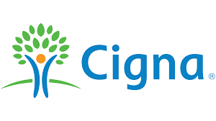

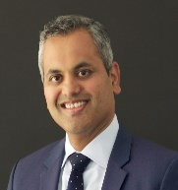

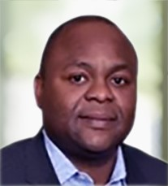
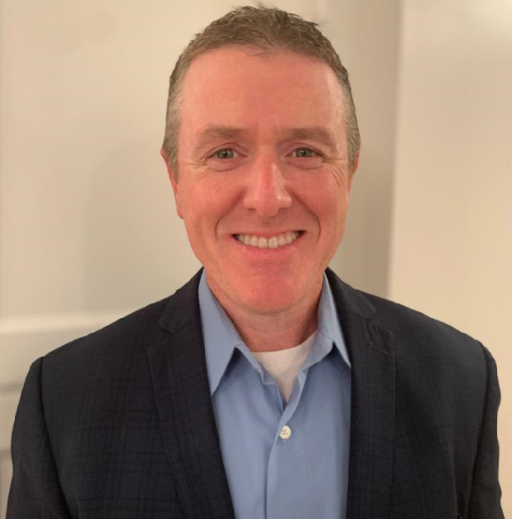




Team structure and fee model
Given the strategic importance for this engagement, we are proposing a balanced team of resources with the right mix of functional, change management, and program management experience. Please see Appendix C for team resumes detailing KPMG resource’s experiences and qualifications.
Executive Sponsorship
Executive Sponsor – The KPMG team’s main point of contact; works closely with KPMG throughout the engagement for governance and oversight.
Engagement Partner – Provides leadership, domain expertise, and analytics and design guidance to the project team.
Chetan Gavankar
Engagement Partner – Cyber Security Services
Daniel Guistolise
Engagement Managing Director – Transformation Delivery
Steering Committee
Steering Committee – Team empowered with the authority to take binding decisions to move the program forward at the required pace.
Engagement Director – Provides day-to-day leadership, domain expertise, and analytics and design guidance to the project team. Responsible for overall delivery of the project.
Ope Odebiyi
Engagement Director – Cyber Security Services
Gregory Pendleton
Engagement Director –
Transformation Delivery
Core Team
Core Team – Team responsible for reviewing and vetting solutions to be presented to the Steering Committee
Core Delivery Team – Professionals from onshore, nearshore, and offshore that are responsible for executing project activities, performing project management tasks, and developing and quality controlling deliverables.
Project Manager
Project Manager – The KPMG team’s day-to-day contact; works closely with KPMG throughout the engagement to provide tactical guidance, support interview and workshop scheduling.
Anurag Rai
Cyber Account Partner
Stakeholders
Functional Leads Technical Leads Operational Leads Business Leads
Stakeholders – Domain experts and key stakeholders not on the Core Team or Steering Committee. Participate in interviews, ad hoc meetings, and workshops as needed.
Onshore, Nearshore, and Offshore Supporting Resources
Project Management Office (PMO Team)
Transformation Delivery

Slide 19
Detailed pricing
KPMG is looking forward to working with you on this project. Our fees estimate below are provide on a fixed fee basis. We do not anticipate incurring expenses during the delivery of this engagement as all work will be done remotely. If travel is required, we do not anticipate expenses to exceed 15% of the engagement fee.
# | Workstream | Fee
1 | Security services catalog development and capability governance | $165,000
2 | Develop Organizational Governance | $150,000
3 | Enhance and support the Portfolio Management Office (PMO) – 6 month support not included | $235,000
4 | Agile Acceleration and Transition | $82,900
5 | Enhance CIP's BISO Program | $175,000
6 | Establish a modernized organizational structure and role profiles for CIP | $155,000
7 | Change management for execution activities | $165,800
Total | Total | $1,128,700.00
Timeline
We anticipate this work effort to span 15 weeks. We will run workstreams in parallel, with the project management construct being established in such a way to manage interdependencies across the workstreams. Given the compressed timeframe of this engagement, we anticipate providing draft deliverables around the 10 week mark, to allow for review and feedback by Cigna. We will host weekly touchpoints with Cigna to provide continuous and transparent visibility into our engagement status.

Slide 20

Appendices

Slide 21
Appendix A: KPMG’s trusted relationship with Cigna

Slide 22
Proudly serving Cigna
As your trusted advisor, KPMG helps improve business performance, reduce risk, and enhance value. We are committed to bringing superior people, ideas, service, and partnership. Our proposed team has developed project accelerators that will allow us to move at a pace required by Cigna while not sacrificing the level of quality and depth of knowledge that comes with practical experience. The following is a list of projects where we currently demonstrate this promise.
Contract lifecycle management
Simple. Aging legacy system, disconnected manual process, and complex products were negatively affecting the client experience at ESI. We redesigned your business processes and partnered with Stratera to deploy innovative Apttus CLM technology. By helping you view the customer experience as a unified journey, we were able to help you transform the client experience to continue delivering market-leading quality with improved speed and value.
IAM transformation support
R&D tax credit
Cyber metrics program assistance
Global tax compliance and transfer pricing services
Affordable. Established single points of contact at Cigna in each of the 18 countries to coordinate and provide non-U.S. direct and indirect tax compliance and preparation of transfer pricing documentation. We have been able to help you standardize processes thereby driving efficiency and cost savings.
Tax restructuring
State tax return review
RPA PMO support
Technical accounting support
Predictable. Provide specialized accounting support through the launch of the Ascent GPO. We continue to serve as trusted advisors based on our long-standing relationships and understanding of the complexities within the business.
Tax integration support
Valuation & accounting advisory services
Sales & use tax compliance
Finance enablement – EBS cloud planning
Affordable, Simple. We were hired to help you understand the drivers of the Specialty Pharma PMPMs over time, specifically to assist the pricing team in developing a new product. While working closely alongside your team, we developed regression models and made recommendations for future extensions which will aid in data migration for on-prem to the cloud. We shared proof of concepts with you which will ultimately help you to minimize costs of expensive applications.
Data migration
Global tax compliance & transfer pricing services
Finance integration support
Dynamic funding
Affordable, Predictable, Simple. In the midst of an agile transformation journey, you recognized the ability to manage investments dynamically as an imperative. We partnered with you to frame, design, pilot, and implement a funding model for technology investments. Our team took an agile approach to stand up the new funding model in a series of iterative releases in parallel with the existing planning and budgeting cycles and assisted the client with a transition plan to address the evolution of new governance forums, roles, and enabling artifacts.
Client service transformation design and implementations
Leasing tool implementation
Orange to blue book conversion
Accounting advisory support
Intercompany transformation support
Identity access management transformation
Affordable, Predictable, Simple. As a result of a Cyber Maturity Assessment and previous work with ESI, we are supporting improvement activities within the entire organizations IAM stack to enable Cigna to function without any limitations around access and people while keeping data security and broader cyber risks in mind.

Slide 23















Shared focus and commitment to diversity
It is no surprise that Cigna and KPMG work so well together. We both share a deep, powerful commitment to the highest principles of corporate values and culture. It is about doing good—for our people, our communities, the environment, and the future. We do not just talk about these principles—we live them each and every day. And we are proud to work with Cigna, who shares these same corporate values.
Cigna
KPMG
Diversity networks
Diversity networks (Business Resource Groups (BRGs))
African American/Black
Aspire (Asian/South Asian)
Juntos (Hispanic/Latino)
Generations (Multigenerational)
Pride (LGBTQ+)
ABLE (Achieving Better Lives for Everyone)
Salute (Veterans)
UpLift (Interfaith)
UpNext (Career Mobility)
Virtual
WIN (Women Influencing and Networking)
Abilities in Motion
African Ancestry
Hispanic Latino
Inclusion Councils
KPMG Network of Women (KNOW)
Veterans
Pride
Asian Pacific Islander
Core values
We care deeply about our customers, patients, and coworkers
We partner, collaborate, and keep our promises
Corporate values
We create a better future—together
We act with speed and purpose
We innovate and adapt
Integrity: We do what is right
Excellence: We never stop learning and improving
Courage: We think and act boldly
Together: We respect each other and draw strength from our differences
For Better: We do what matters
Cigna Foundation and Piedmont Heart Institute
To help raise awareness of heart health risks, especially among women, the Cigna Foundation has teamed up with Piedmont Heart Institute. By providing a $449,000 grant, the Cigna Foundation is helping Piedmont Heart Institute expand its Women’s Heart Program to additional communities in Georgia, allowing more at-risk women to access holistic cardiovascular care.
KPMG and American Heart Association
KPMG is proud to support the American Heart Association (AHA) and its work to help us all live healthier lives free of cardiovascular diseases and stroke. KPMG partners and employees support the AHA through Heart Walks, Go Red for Women, Heart Balls, Little Hats Big Hearts, and Cycle Nation with over $787,012 total contributions.
Awards and achievements
KPMG is proud of the awards we receive each year in recognition of our continued commitment to our people and driving inclusive growth.

Slide 24
Appendix B: PMO (Workstream 3)

Slide 25
A critical function of the portfolio management office is to link strategy with execution
Our approach to establishing effective an effective PMO aligns execution to strategy by orchestrating the selection, prioritization, execution and measurement of projects, products, portfolios and change initiatives across the enterprise.
Strategy
Execution
Change Management
Financial Ambition
Portfolios
Markets
Where to play
Business
Model
Propositions & Brands
Ideate &
Plan
Execute & Guide
Clients & Channels
PMO
Digital Transformation
Business Unit Portfolio
Core Business Processes
Operational / Tech. Infrastructure
Data, Analytics & Tools
Product Portfolio
Program / Epic
Org Structure, Gov. & Controls
How to win Operating Model
Monitor & Improve
Manage & Govern
People & Culture
Value Measures & Incentives
Major Acquisition
Digital Innovation

Slide 26
We will immediately prioritize and focus on critical PMO capabilities
In our view, a mature PMO leverages 16 capabilities across 4 distinct phases of the lifecycle to align strategy to execution.
Ideate & Plan
Execute & Guide
Drives alignment to strategy through the identification, evaluation, approval, prioritization, and sequencing of work
Supports delivery of programs, projects and products through techniques, tools and methods to guide the work
Change Management
Strategy
Delivery Management
Intake & Business Case
Capability Development
Prioritization
Ideate &
Plan
Execute & Guide
Quality Management
Resource Capacity Planning
PMO
Change Management
Monitor & Improve
Manage & Govern
Establishes processes and mechanisms that monitor the effectiveness and quality of projects and products across a portfolio
Defines standards, structures, approvals and processes for how initiatives should be governed and managed
Performance Reporting
Data, Analytics & Tools
Governance & Comms
Monitor & Improve
Manage & Govern
PPM Tools
Risk Management
Continuous Improvement
Methods & Standards
Value Realization
Funding & Investment

Slide 27
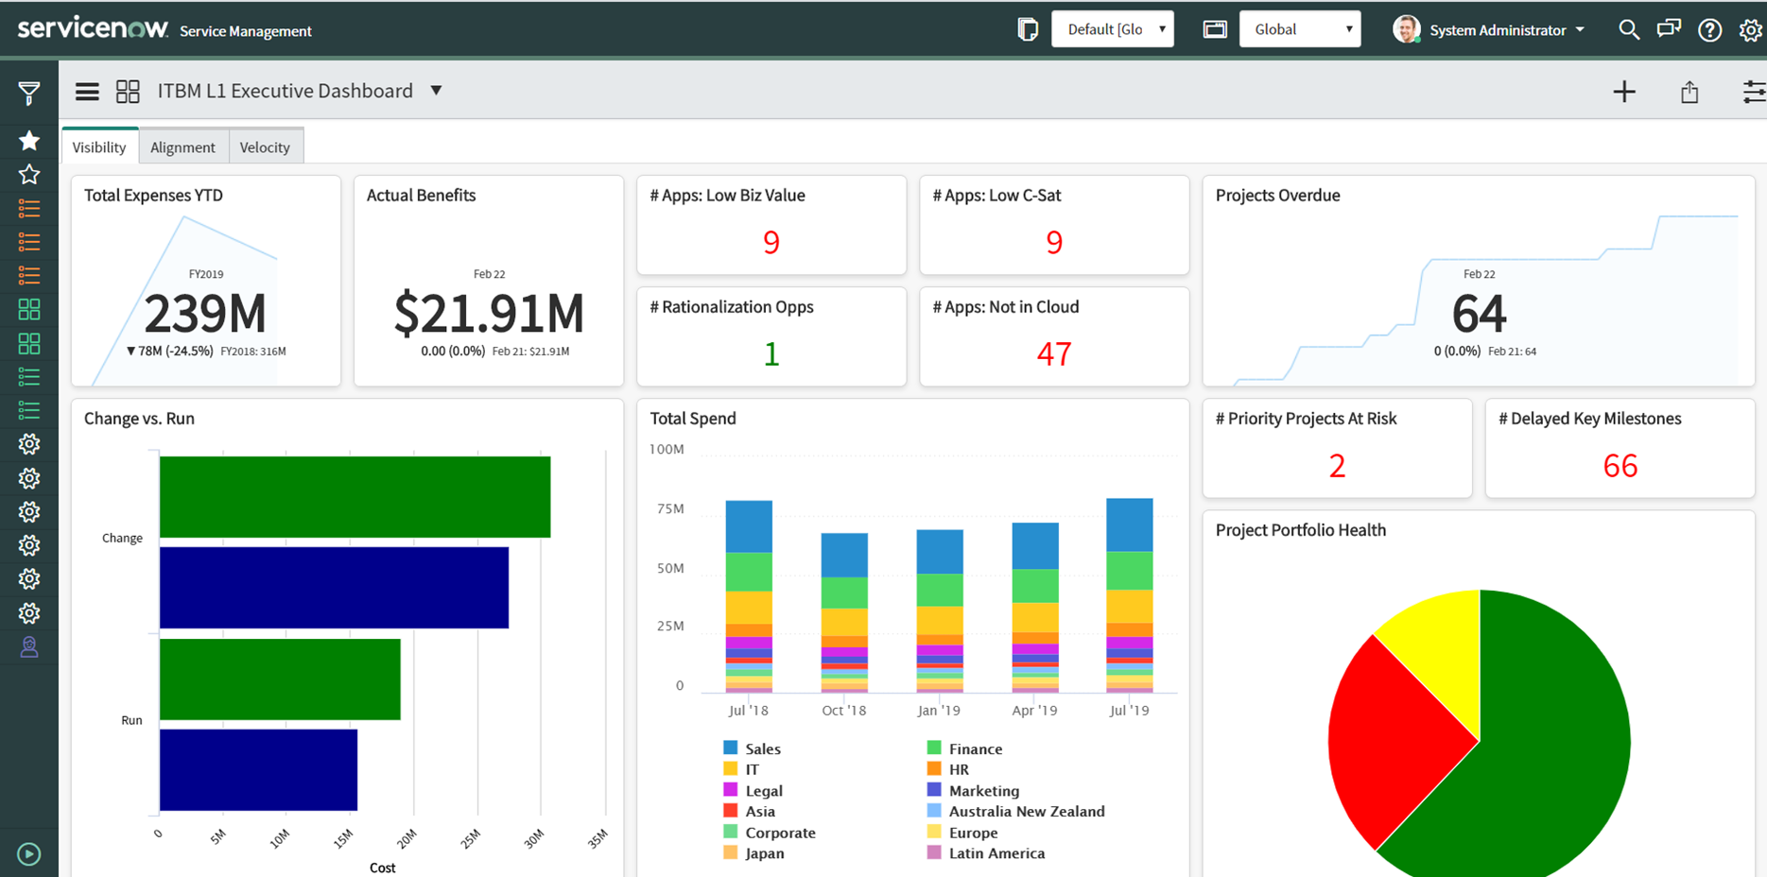
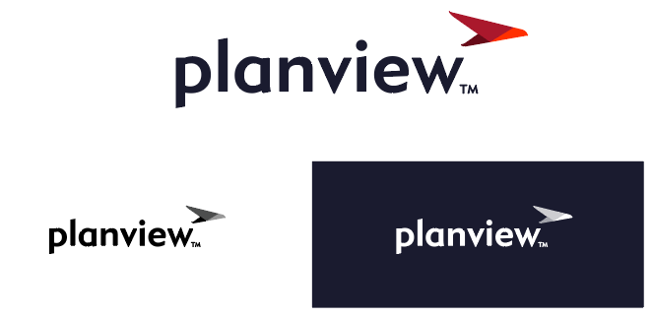


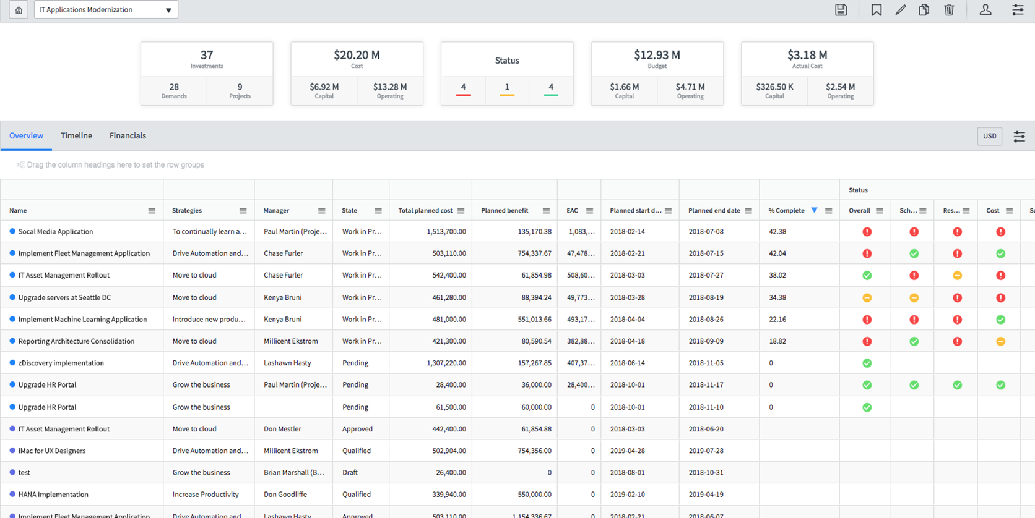

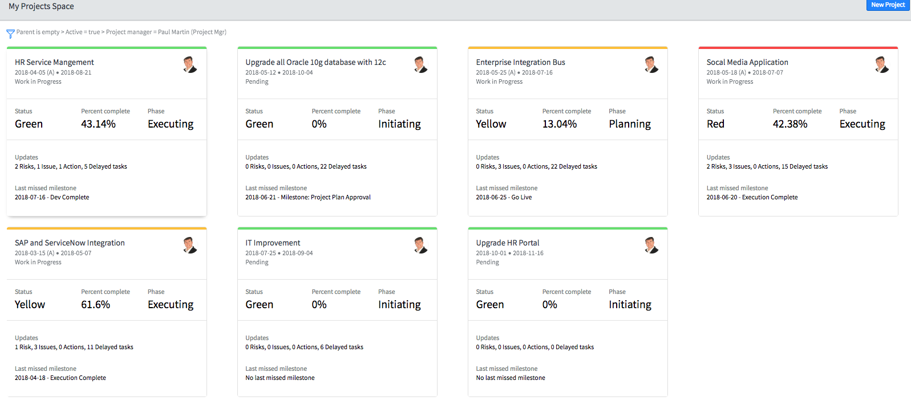

We will leverage data, analytics and tools to provide meaningful insights
The effectiveness of PMO capabilities is closely linked to an organization’s ability to collate the right data, provide meaningful insights and automate through each phase of the lifecycle.
Data
Analytics
Tools
Each of the 16 PMO capabilities depends upon and / or produces data broadly aligned to the following categories:
Applying analytical thinking to these data sets provides meaningful insights and reports that enable the PMO to add value:
With the data and reporting requirements defined it is then important to consider what tools are available to manage data and provide reports.
PPM Tools: We leverage PPM tools that can provide both workflow and reporting:
Business Case & Goals
Portfolio Dashboards
Financial (Costs & Benefits)
Portfolio Reports
BI Tools: We also utilize dashboard tools for advanced reports and visualization needs:
Project / Product Performance
Project Boards
Resource Capacity & Demand

Slide 28
Continuous and integrated planning is key to prioritizing and finding the right balance of your portfolio
The optimization of a portfolio of projects or products is predicated on good strategic planning which provides the guardrails and criteria to support prioritization decisions on a continuous cycle.
Planning Activities
Roadmap Development
Strategic Alignment
Scenario Modeling
Transparency & Retrospectives
Develop a roadmap for strategy execution over a longer time-frame to inform the planning process
Frame new initiatives with identifiable outcomes that can be mapped to strategic goals and KPIs.
Visualization of constraints and options to better support sequencing of work.
Disciplined reporting of KPIs / OKRs and feedback loops allows deeper understanding of outcomes.
Strategy
Intake
Prioritization
Delivery
Planning Constraints
Prioritization Criteria
Funding & Investment
Resource Capacity
Business Value
Risk Reduction
Time Criticality

Slide 29
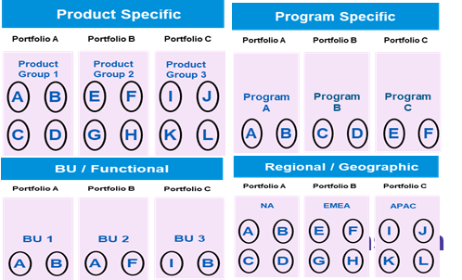
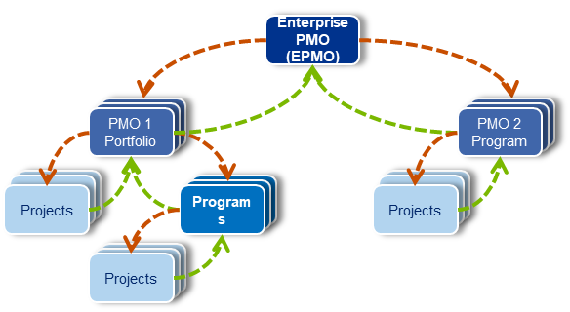
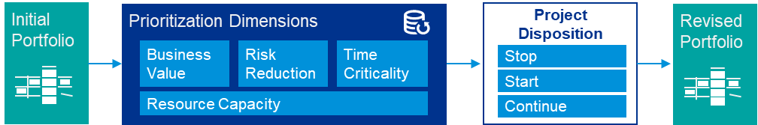
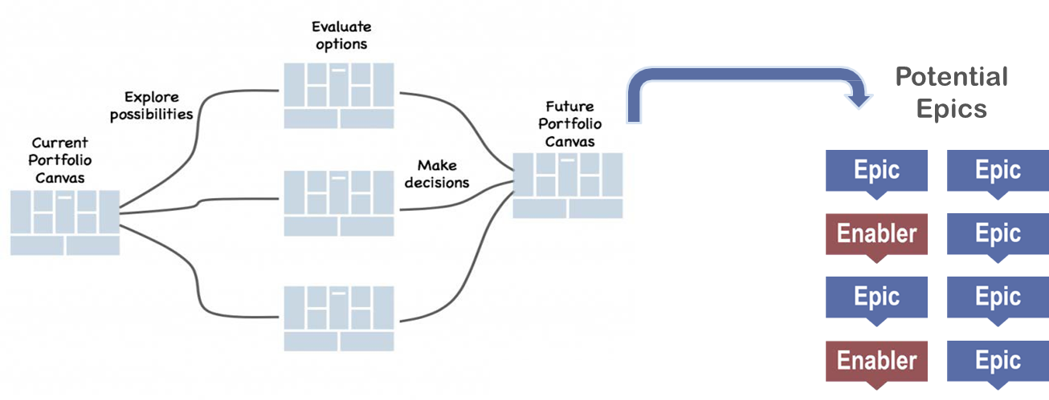
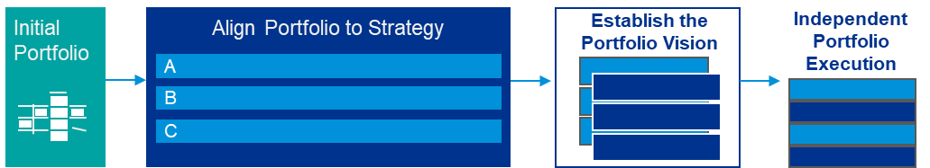


We will design flexibility into your portfolio model to better respond to new challenges
Designing the right portfolio structure is the foundational element as it will inform the other elements of the PMO design.
Design questions to consider…
Traditional Portfolio Structure
Existing Delivery Model
Delivered in a traditional waterfall or agile methodology?
Functional Silos or Value Streams?
Top-Down or Dynamic funding?
Centralized or Decentralized work Intake?
Governed via Phase Gates or Independent Release Trains?
How should the PMO interact with the other PMOs (e.g. Supply Chain, IT PMO)?
Is the intent to have a fully centralized PMO or more of a hybrid model (hub and spoke)?
How should the portfolio’s be organized to ensure the most effective management?
How much of the portfolio is expected to be agile model in the future (vs waterfall)?
Lean Agile Portfolio Structure
Epics & Enablers
Portfolio Kanban

Slide 30
Strike the right balance between project portfolios and lean agile portfolios
Our approach can support both project portfolios and lean agile portfolios. The extent to which Lean-Agile techniques are adopted in your organization will drive key design decisions when building an PMO.
Project Focused
Lean-Agile Focused
Strategy
Annual planning
Quarterly roadmaps
Design levers
Ideate & Plan
Intake & Business Case
Larger capital programs
Lightweight business cases
Prioritization
One-time prioritization
Continuous reprioritization
Resource Capacity
Fractional allocation of FTEs
Fixed capacity / fixed teams
Delivery Management
Waterfall, milestone based
Agile, iterative delivery
A key activity in the design process for an PMO is to determine the extent to which you want to adopt project vs lean-agile methods to manage the portfolio.
Our approach is not an “either / or” but rather is designed to enable a hybrid portfolio of work by adjusting which agile principles will be adopted within each element of the PMO.
Execute & Guide
Capability Development
Training and skills focus
Community of practice
Quality Management
Deliverable driven
User experience driven
Change Management
Communications-led
Demonstrations-led
Governance & Comms
Centralized
Distributed
Manage & Govern
Risk Management
Mitigation planning
Removing impediments
Methods & Standards
Documentation / compliance
Guidelines / best practices
Funding & Investment
Fund projects and programs
Fund value streams
Performance Reporting
Scope, Schedule, Budget
Objectives & Key Results
Monitor & Improve
PPM Tools
Project Management tools
Agile Delivery Tools
Continuous Improvement
Project Lessons Learned
Retrospectives
Value Realization
Project Objectives
Business Metrics
Illustrative

Slide 31
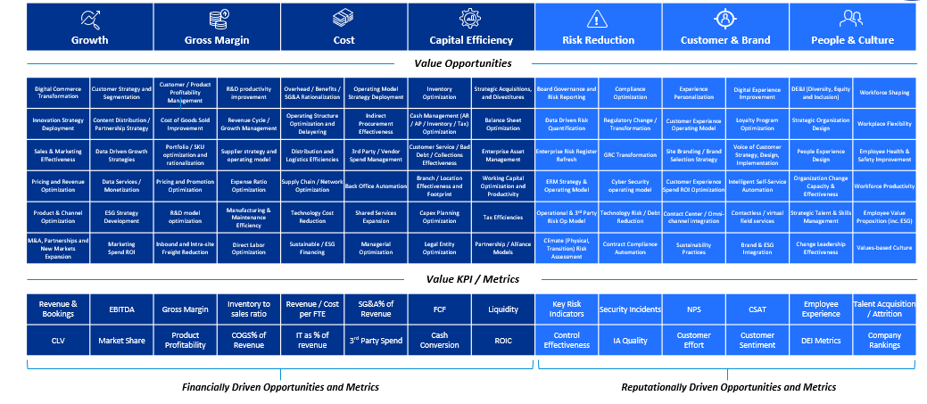
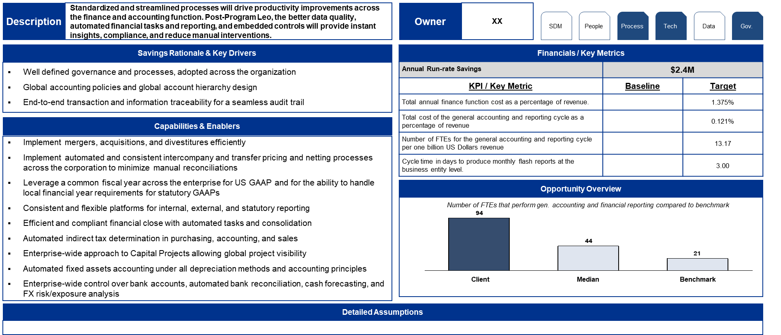
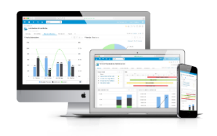
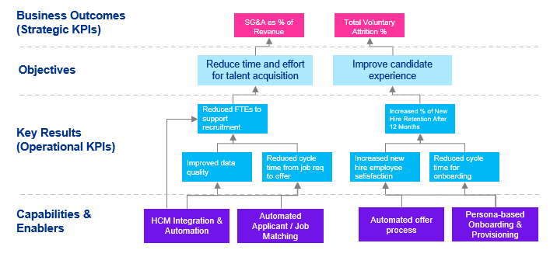
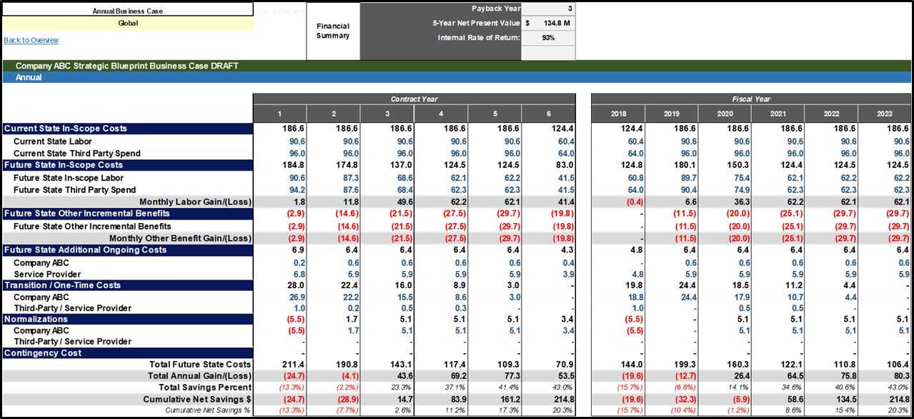
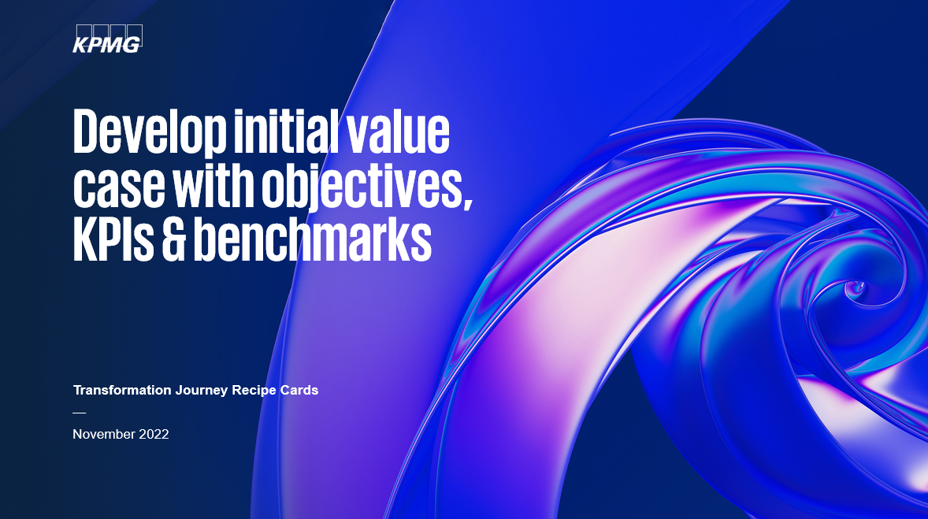
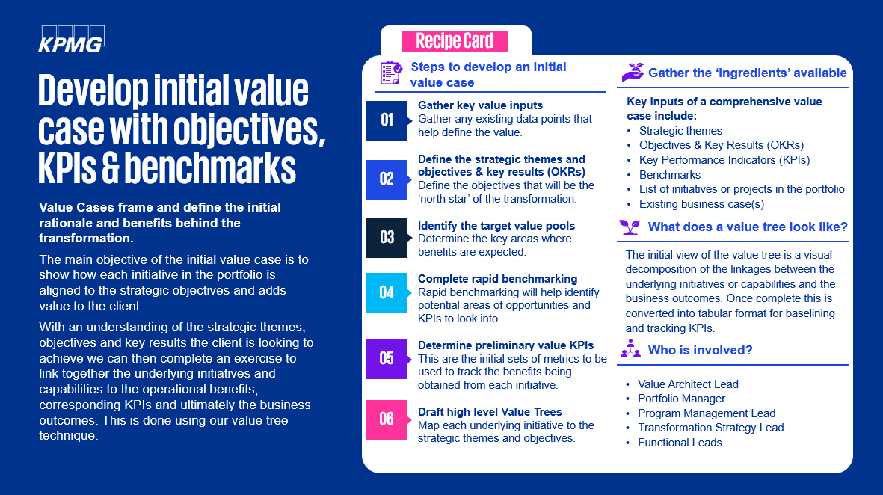
Our tools and templates will accelerate the BISO program’s value management lifecycle
The value management lifecycle is enabled by the following activities on an ongoing basis:
01
02
Value
Case
03
Value
Governance
04
Tools, KPIs & Reporting
Value Tree
Value trees are visual decompositions of the linkages between the underlying capabilities and the business outcomes. They frame and define the initial rationale and benefits behind the transformation.
Value cases show the flow of value, quantifying the current state, future state, costs to achieve, and any change impacts. They include the set of indicators to track value realization progress as part of the transformation.
A proper value realization plan includes a clear governance structure, roles & responsibilities, change controls, value leakage mitigation plans and escalation procedures that are aligned with the program governance.
Value tools provide increased levels of support and standardization. Larger programs can leverage the Shibumi platform for KPI tracking and analysis, while any project can benefit from existing templates, financial models, recipe cards, libraries and examples.
Value Tree
Value Case
Governance Components
Accelerators
Governance structure
Shibumi dashboards
Value management roles, responsibilities (RACI)
Weekly / monthly value tracking process
Recipe Cards
Impact Assessment and mitigation plans

Slide 32
Appendix C: Agile (Workstream 4)

Slide 33
Partnering with clients in their Agile transformation
What does it mean to partner on an Agile transformation?
How do we do it?
Our high-level plan
Adopting the mindset is more than forming teams, building backlogs, and cadence based delivery. Transformation is about systematically removing barriers to allow that to happen.
Our holistic approach provides techniques and tools to orchestrate a set of transformation initiatives in a way that drives value@velocity and creates the right experiences for all stakeholders, while still ensuring the day to day delivery needs are met.
We mobilize around 6 proven phases of transformation:
01
Get Organized. We work to define a schedule of change based on maturity.
Beyond adopting Agile practices and culture: Transformation to an Agile Mindset and Delivery Model is about creating better business outcomes. We start by identifying what outcomes are most important to your company’s success.
02
Get Predictable. We stabilize teams. Bring clarity to the work to be done and establish the necessary conditions to build and improve.
We put people first.
03
Get Technical. Reduce batch size. Promote cadence at the enterprise level. Harden and baseline dashboards and metrics.
Educate
Enterprise
Program
Empower
Products
Teams
Trust
Executives/Business
Teams
Project
01
Align businesses delivery perspective with customer values
04
Get Rid of Dependencies. Overhead and risk due to dependencies is mitigated where they are related to business and organizational hierarchy.
02
Bring forth industry experience and expertise
Get Local. Initiate team based funding and adaptive governance. Change how funds are allocated and how you manage the economics of delivery.
05
03
Build trust with the enterprise organization
Our plan revolves around people. We work to create connected, powered and trusted teams and promote confidence in their work. Business describes the vision while the people on the teams create the solution.
06
Get Smarter. Innovate and educate both with in and outside the product to self-solution.

Slide 34
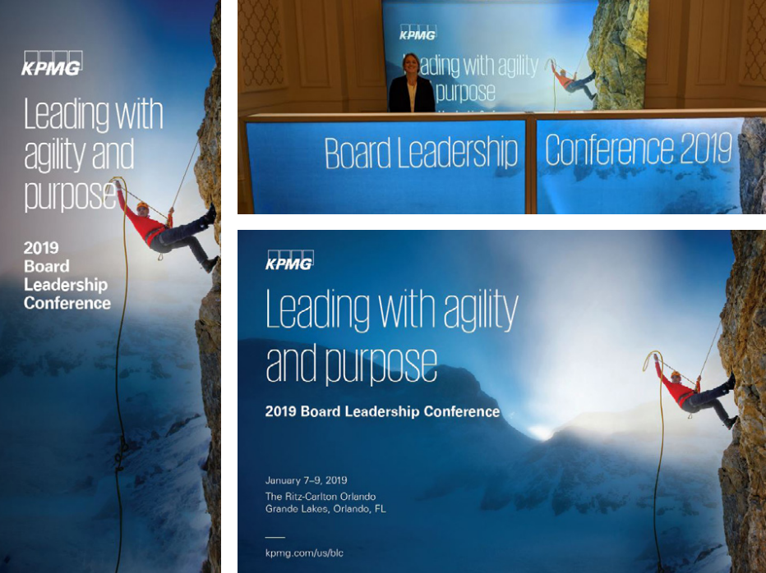
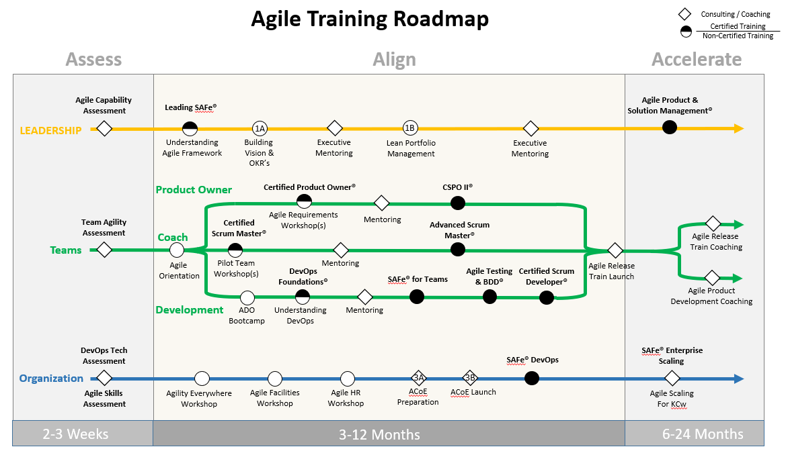
KPMG knows custom content
KPMG utilizes subject matter professionals and our designer teams to deliver rich educational content.
The Agile learning program (powered by Ignition) is a customized experience aimed at creating actionable experiences that drive meaningful change and understanding.
Content is custom created based on the need, vision and method to deliver the education in alignment with the level of the participants.
Virtual or in-person presentations, brochures and factsheets; playbooks and roadmaps help make Agile content rich and actionable.

Slide 35
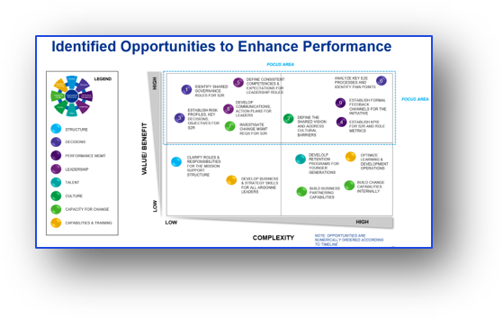
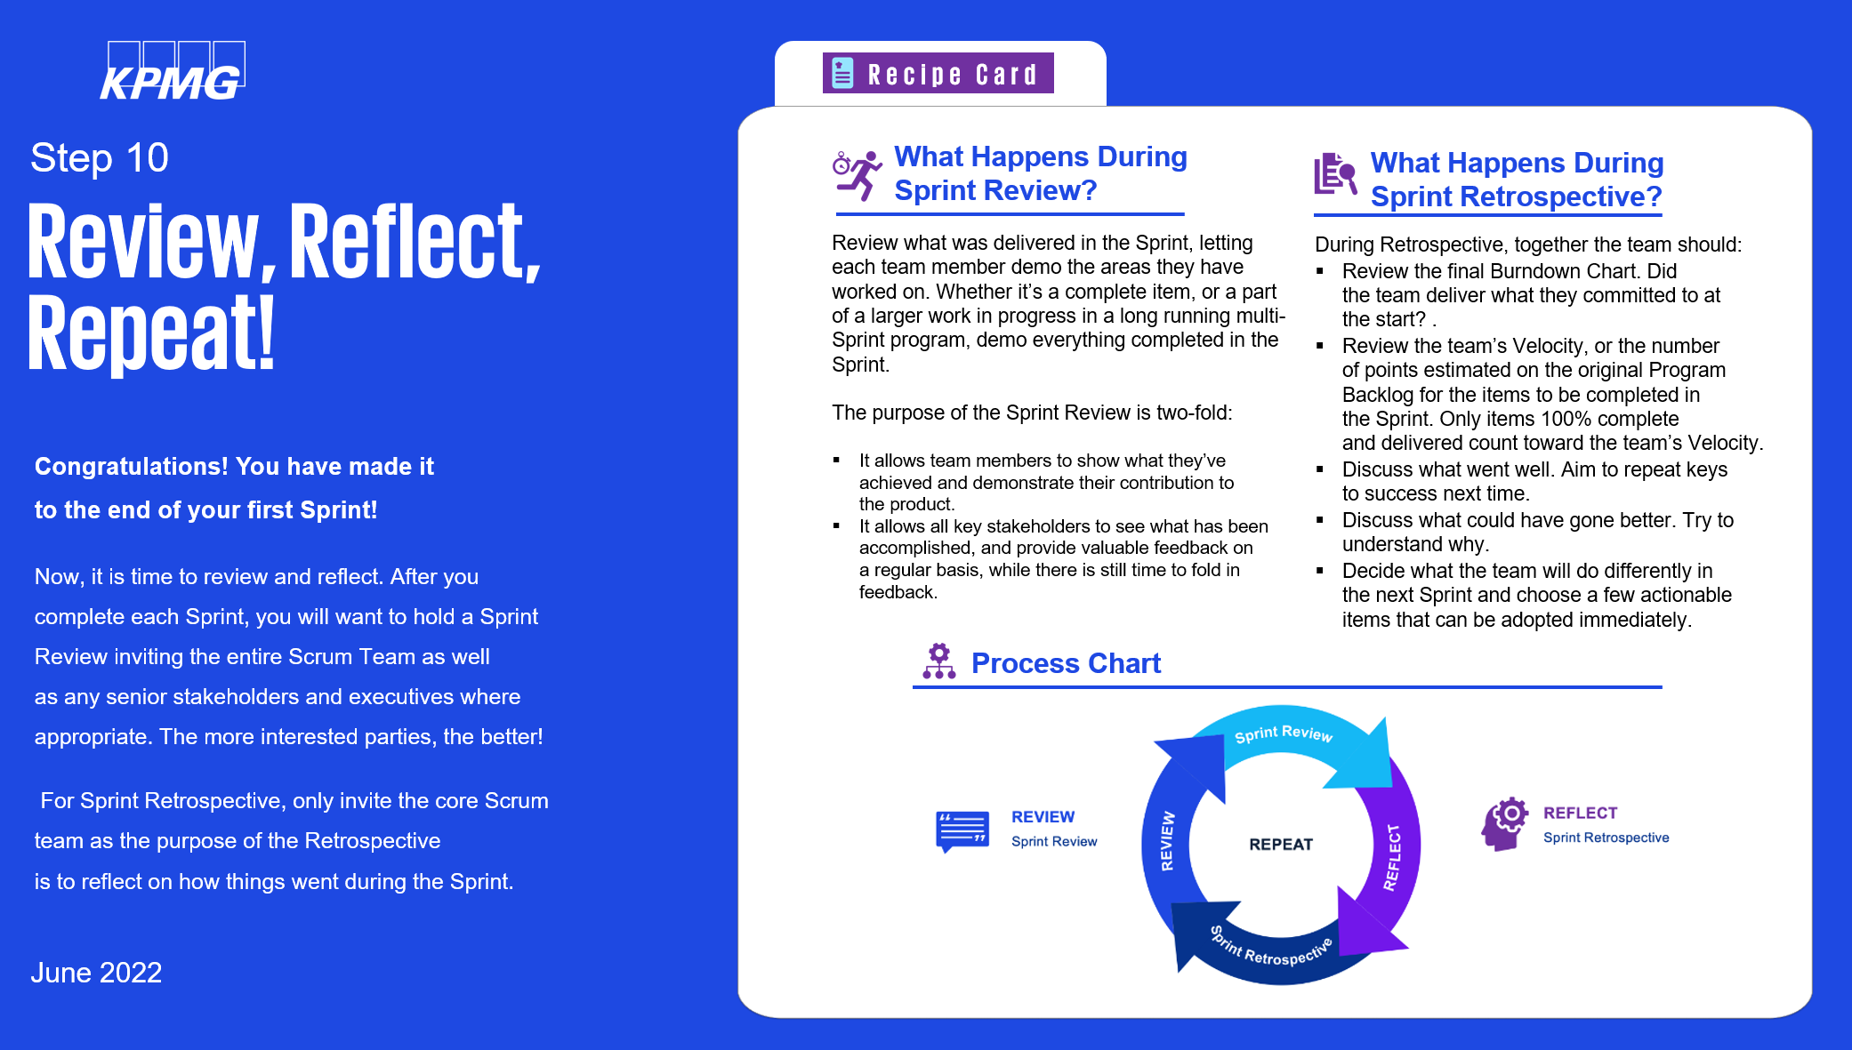
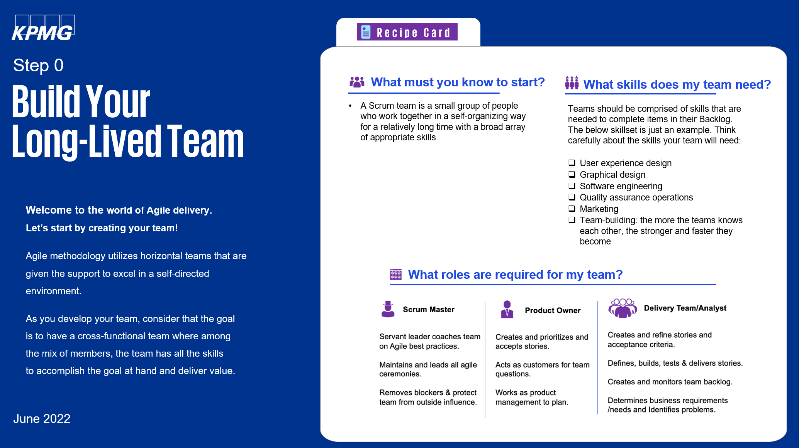
Pinpoint Agile delivery
Content is delivered in bite-sized pieces that feed the playbook
We have found that dividing content into manageable small chunks (much like Agile User stories) allows the reader to get what they need and get back to creating value. When collected, the sum creates a playbook that allows for a comprehensive understanding of Agile@Cigna. We can create comprehensive reactive documents that give drill-down detail.

Slide 36
Appendix D: Organization Design (Workstream 6) and Change Management (Workstream 7)

Slide 37

Organization Design: Our high level approach
Our four phased approach helps organizations identify and design both the requisite structures and the critical supporting organizational elements that equip people to excel in their roles and teams.
STATE IT
SHAPE IT
SEE IT
See how the future state vision comes to life through the detailed design and transition planning, assessing impacts at the individual role level
SUSTAIN IT
State the current business context and future aspirations, the opportunities and ambitions to be addressed, and the critical success factors for the future
Shape the future design by analyzing the current design, identifying the root causes of performance, and developing the aspirational high level design
Sustain the integrity of the
design through detailed transition execution, and monitoring and measurement led by internal organization design capability

Slide 38

Our detailed Approach to CIP’s Organization Design
Our four phased approach helps organizations identify and design both the requisite structures and the critical supporting organizational elements that equip people to perform highly in their roles and teams:
Goals
Clear statement of client context, strategy and aspiration
Clear future state vision and agreed critical success factors
Value Chain Analysis to identify processes and roles that create value
Client organization design capability assessment to shape project team
Clear design constraints and project ways of working
Clear current state baseline analysis to confirm pain-points to be addressed in the design
Refined critical success factors and design principles to inform design and option analysis
Future state options evaluated through design principle analysis.
The high level Macro organization design with aligned KPIs
Goals
State the current business context and future aspirations, the opportunities and ambitions to be addressed, and the critical success factors for the future
Shape the future design by analyzing the current design, identifying the root causes of performance, and developing the aspirational high level design
STATE IT
SHAPE IT
SEE the organization, through:
Goals
SUSTAIN the performance, through:
SUSTAIN IT
SEE IT
Goals
The detailed Micro organization design
The workforce transition strategy for the shift to future state
Role impact assessment for each impacted role
A detailed workforce transition plan to equip people for new roles
A pilot and rollout approach for full transition
Pilot delivery and rollout
Set up future state organization by executing workforce transition plan
Monitoring effectiveness of future state organization design against tailored KPIs
Enhancing client organization design capability as required
Conducting mentoring check-in to support capability build
Sustain the integrity of the design through detailed transition execution, and monitoring and measurement led by internal organization design capability
See how the future state vision comes to life through the detailed design and transition planning, assessing impacts at the individual role level

Slide 39
Micro Organization Design: Role Profile Definition Approach
Role Profiles demonstrates the relationship between specific capabilities and the personal attributes required to undertake by level or role.
Identify roles required to sustain future state
Determine critical success factors
DESIGN
Outline Role Needs
Expand on role descriptions, reporting structure, and capacity needs
Determine existing or new resources to fulfill roles
Evaluate and measure against critical success factors
IMPLEMENT
Fill and Measure Roles
Confirm roles are necessary for ongoing BAU
TRANSITION
Finalize
Role Profiles outlining Role descriptions, reporting lines, accountability, critical success factors

Slide 40
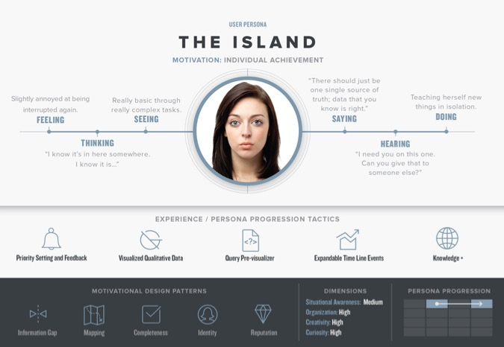

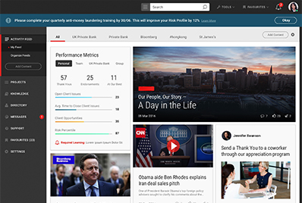
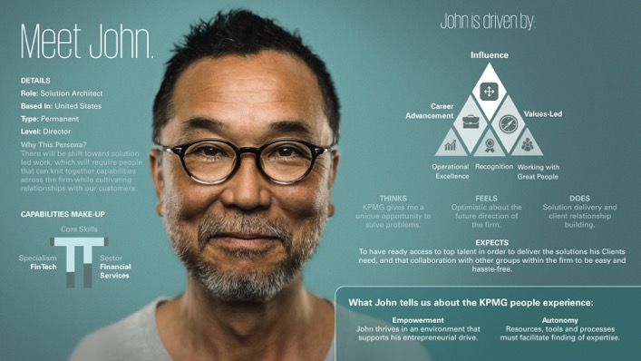

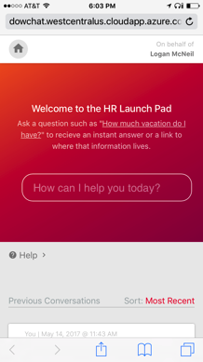
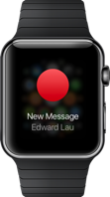
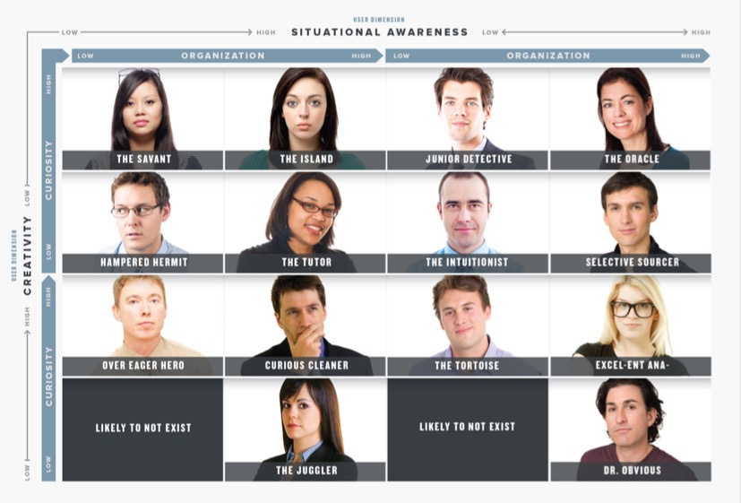
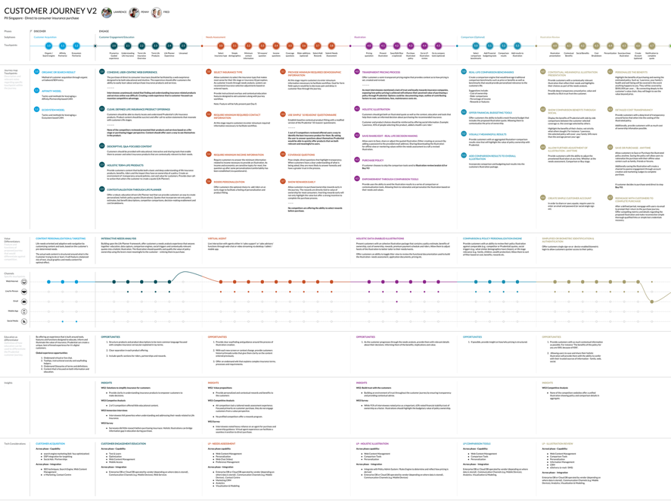
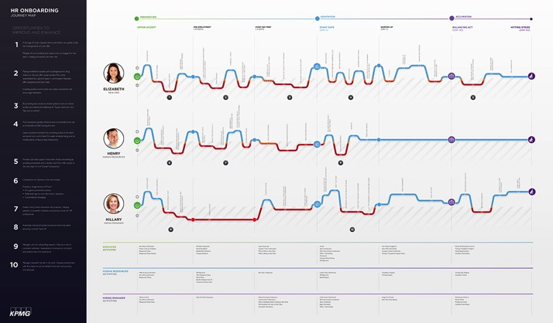
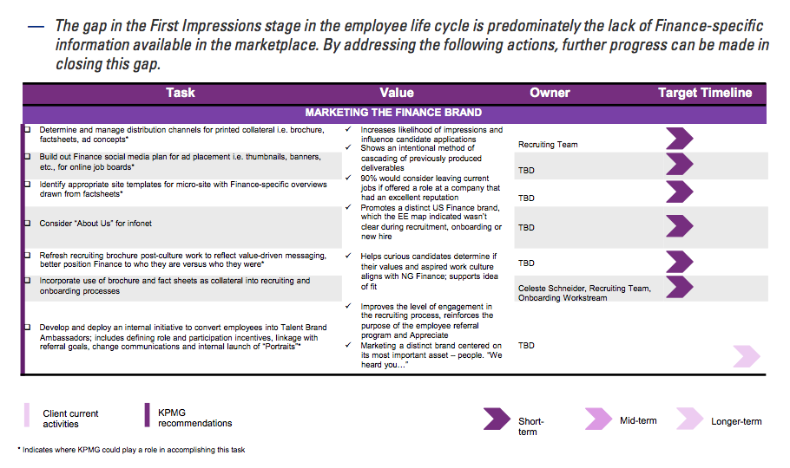
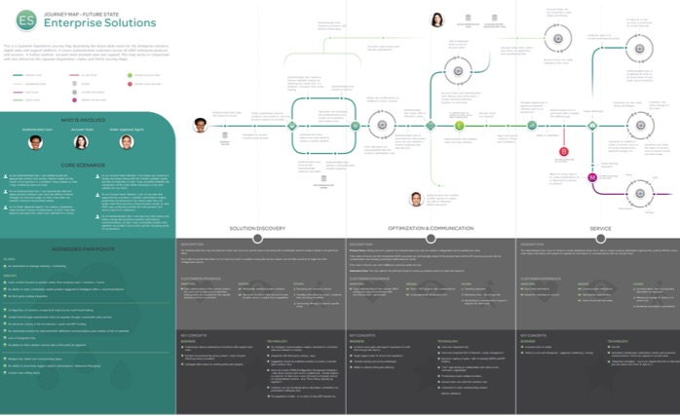
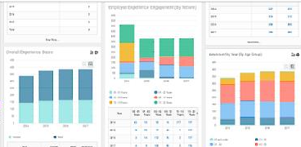
Our approach emphasizes the employee experience through transformation
Make it Clear
Make it Known
Make it Real
Make it Happen
Make it Stick
Align leaders around the strategic aims, ambition, and scale of proposed change to the organization
Communicate the change vision and case for change and begin to create ownership around the solution
Translate the change vision into reality for people in the organization and define what it means for them
Move the organization towards the end state and equip people to operating in new ways of working
Ensure that there is capability in the organization to be able to sustain the change in the long-term
Key Activities:
Interview key leaders on their vision for the transformation
Create leadership action plans across all phases of the project
Conduct stakeholder interviews & ethnographic research
Key Activities:
Build and deploy future state journey maps and other visualization tools
Continuously conduct checkpoints for change and impact readiness
Update change management strategies and plans
Key Activities:
Capture and monitor change and adoption metrics post go live
Capture lessons learned to improve subsequent go lives
Key Activities:
Develop empathy maps to support effective change communication
Create baseline readiness assessment for the organization
Identify future state behaviors to support changes in process, technology, culture, etc.
Key Activities:
Continuously conduct checkpoints for change and impact readiness
Draft and develop training materials in preparation for go live
Deploy interactive training methods
Execute on workforce transition and go live communications
Understand business needs and goals through product strategy and technological assessments
Conduct end user research and behavioral analyses to inform persona and journey map creation
Develop the information architecture and workflow mapping through visual design tools
Conduct user testing and testing analysis through interactive prototyping of future state design
Develop the implementation roadmap through the use of visual assets and design documentation
Preparing for my Journey
Discovering What’s Ahead
Finding Purpose
Exploring my New Reality
Living the Change

Slide 41
Key focus areas for change management
Implementing a successful change management program from the start can pay massive dividends and result in better end user adoption. We will create a program that is tailored to Cigna’s culture and business needs starting at the kickoff of the program.
Stakeholder Management
Identifying impacted stakeholders across the organization and maintaining their engagement throughout the transformation
Documenting the impact of change from a role, process, and technology perspective and addressing through change plans
Impact of the transformation
Key opportunity areas:
Assessing level of commitment and buy in across key stakeholder groups to focus our change efforts
Incorporating feedback of key stakeholder groups into the design of the future state to maximize the rate of adoption post go live
Key opportunity areas:
Identifying the areas of the organization that are most significantly impacted, and being strategic with how we address that impact
Maximizing user adoption by recognizing areas of your business that might require additional learning or communications
Key opportunity areas:
Bringing your key impacted stakeholders along the journey and creating a sense of ownership of the future state
Communicating the “What’s In It For Me” by stakeholder group to further drive adoption and share the benefits across CIP
Key opportunity areas:
Creating role-based learning with content that is both relevant and timely for the specific audience being trained
Developing easy-to-digest material, and delivering through a blended model that embed the capabilities within CIP and the flow of work
Communication and awareness
Creating a campaign around the program that builds momentum, awareness, and excitement for the future state operating model
Ensuring that the skills and capabilities to successfully operate in the new ways of working are embedded within the organization
Learning and education

Slide 42
Appendix E: KPMG Ignition Center

Slide 43
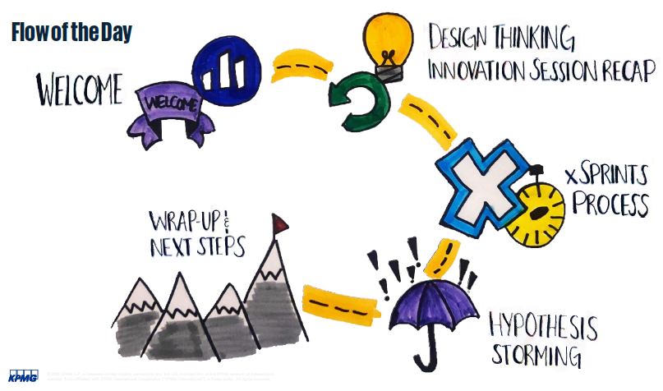
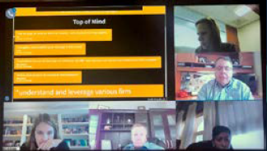
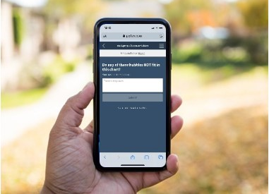
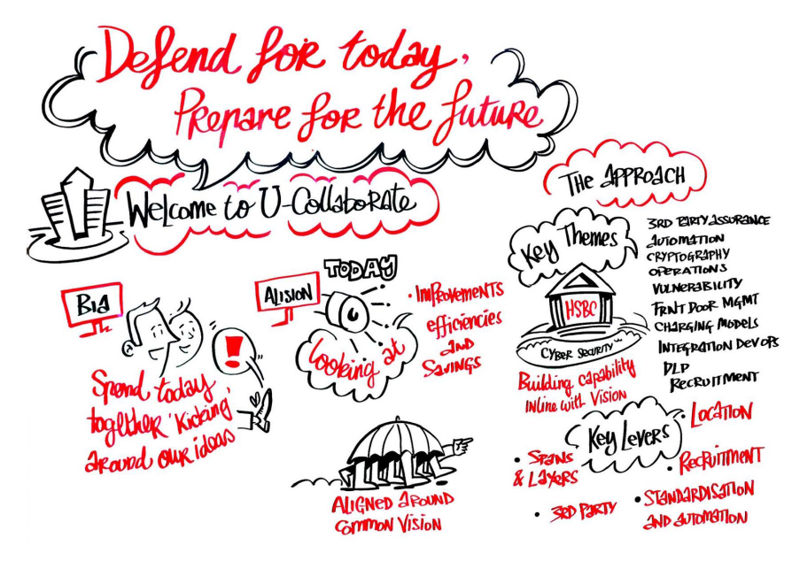
Delivering successfully in a virtual environment
KPMG has invested in a suite of virtual collaboration tools, including KPMG Ignition Center. We will bring our virtual collaboration capability to this engagement to provide you with latest digital collaboration tools.
Our team creates an engaging virtual environment needed to foster collaboration.
KPMG Ignition Virtual enables you to create momentum and drive mission critical and organizational priorities, such as:
Ensure continuity of business and focus on priority initiatives during disruptive times
Collaborate virtually in an environment where physical proximity isn’t an option
Produce tangible, outcome- driven deliverables to drive decision support and actionable next steps
Capitalize on the speed of collaboration by reducing cycles required from linear remote working approaches
What are the benefits of a virtual session?
What is included in a virtual session?
Representative output
Coordinated Ignition Team with extensive facilitation and collaboration expertise
“The Engine Room”
Technology requirements & support
Custom agenda design and execution
Relevant assets and methods
Relevant insights
Output package
Collaboration session agenda
Collaboration session in progress
Example technologies and resources
Host & Connect using tools to provide an intuitive user experience
Share content in a secure cloud environment via tools like Microsoft Teams or client preferred collaboration platforms. We provide flexibility to display a wide variety of content while being platform agnostic
Collaborate leveraging software products that enable us to enhance our activities though real-time collaboration
Interact using tools such as Poll Everywhere, allowing participants to easily interact directly and in the moment
Real-time survey tool
Output deck

Slide 44

KPMG’s Global Ignition Centers drive and accelerate innovation
Our team creates an engaging environment needed to foster collaboration.
Areas where we can help include:
When you need to bring leaders together to solve mission critical problems
When you have projects that are stalled or in danger of derailing due to travel restrictions and work from home policies
When you are facing complex technical and operational challenges
When you need to re-prioritize or realign around new or different key initiatives
When you need to mobilize and enhance your workforce with virtual capabilities required to run day-to-day activities
When you want to understand how to leverage analytics, or explore emerging technology and AI and how they might apply to your business
When you are seeking to improve efficiency through automation

Slide 45
Appendix F: Cyber Risk Quantification and Insights

Slide 46
Cyber Risk Insights and Quantification
What is KPMG Cyber Risk Insights (CRI)?
Cyber Risk Insights (CRI) is designed to address various stakeholders’ tough cyber risk management questions. Example questions include:
Optimize protection
What portfolio of cyber capabilities should we invest in and prioritize to optimize our protection against the threats we face?
Board
CEO
COO
CIO
CRO
CISO
Optimize spend
If we invest $XM in cyber next year, what benefit will this deliver to the business?
Board
CEO
CFO
COO
CIO
CISO
Business
Measure quantitatively
What is our actual risk exposure to cyber attack (likelihood in a year and potential financial impact)? How does this compare against our cyber risk appetite?
Regulator(s)
Board
CEO
CFO
COO
CIO
CRO
CISO
Business
Build understanding
I know cyber is a complex risk with many interdependencies – how can we simply explain our overall exposure?
Board
CEO
COO
CIO
CRO
CISO
Business

Slide 47
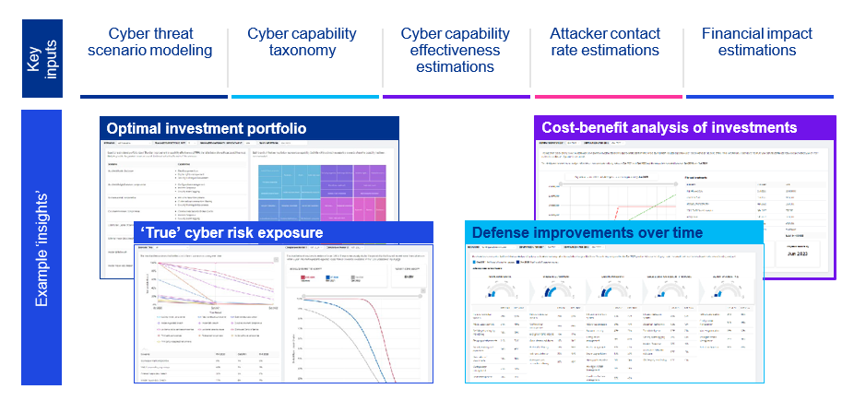
What can KPMG CRI deliver?
CRI answers these questions using powerful and intuitive dashboarding. We can provide out-of-the-box dashboards and bespoke dashboards tailored for your organization. We have robust cyber risk quantification models, methodologies, assets and data to accelerate adoption. We can also help you unlock your data — regardless of maturity.

Slide 48
What to expect from a CRI assessment?
A typical CRI assessment includes four phases.
01 Week 1 | Scoping Identification of exam questions to be answered Identification of potential data sources within the organization to augment KPMG’s data sets
02 Week 2-3 | Scenario selection Identification and attack-tree modeling of priority cyber threat scenarios, accelerated by KPMG’s existing scenario model library
03 Week 3-6 | Estimation and measurement Estimate and measure required inputs for KPMG’s cyber risk quantification models
04 Week 4-8 | Analysis and reporting Reporting to show outputs that answer exam questions identified in phase one We will take your key stakeholders on the reporting journey with us, ensuring that they have the opportunity to buy-in early to a quantitative reporting approach

Slide 49
How to embed quantitative methods for the long-term?
After completing the CRI assessment, we aim to help your organization transition to quantitative cyber risk assessment and reporting for the long-term. We offer a number of business-as-usual deployment models:
C | Bespoke Cyber Risk Insights Solution
B | KPMG Cyber Risk Insights as a Service
A | Licensed access to KPMG’s CRI Web Application

Slide 50
Key Benefits of a CRI assessment?
CRI equips you with the tools to:
Make the case to the board
CRI’s logical and transparent approach helps you to communicate cyber risk to senior stakeholders, demonstrate the business benefits of cyber capabilities and make compelling investment cases.
Target spend to reduce exposure
Graphical risk scenario models allow you to see where your cyber capabilities contribute to risk reduction across the layers of defense and which areas would benefit most from investment.
Carry out systematic, consistent, data-driven assessments
CRI makes the adoption of quantitative techniques quick and simple and improves the objectivity of risk assessments by producing consistent, data-driven results.
Help optimize investments
Determining the optimal investment portfolio of cyber capabilities, to help achieve a great return on investment in risk reduction.
Quantify likelihood and impact
Access to our tried and tested models, which quantify the likelihood of cyber-risk scenarios occurring, the possibility of attackers succeeding across the layers of defense and potential financial losses.
Test investments
Estimate the payback period for an investment or investment portfolio, based on a cost-benefit analysis of spend compared to the expected reduction in cyber losses.

Slide 51
Appendix G: Target Operating Model Framework

Slide 52
Target Operating Model Capabilities
Every function has capabilities aligned to it that are necessary to achieve the desired state.
Program management elements
Strategy & Planning
Policies & Procedures
Security Operations Governance & Oversight
Sponsorship & Funding
Intelligence Lifecycle Management
Continuous Improvement
Incident response
Incident Management
Communications
Legal Activities
Implement Mitigation/ Remediation
Security monitoring
Security analysis
Threat intelligence
Risk analytics
Security engineering & operations
Vulnerability management
Threat-Centric Alerting
Analysis Processes
Situational Awareness
Fraud Analytics
Tool Maintenance
Vulnerability Scanning
Enterprise Visibility
Compromise Evaluation
Threat Discovery
Behavioral Analytics
Capability Development
Configuration Management
Continuous Monitoring
Forensic Analysis
Visualization of Security Data
Device Analytics
Operational Execution
Compliance Support
Compliance Monitoring
Malware Analysis
Security Operations Center Agility
Risk Quantification
Research & Emerging Technologies
Patch Management
Risk Analysis
Intelligence Feeds
Trend Analysis
Log Management
Asset Management
Threat Hunting
Security enablers
Security Exercises
Program, Culture, & Communications
Governance, Risk, & Compliance
Identity & Access Management
Security Architecture
Application Security
End User Compute
Insider Risk
Data Classification

Slide 53
A leader in cyber security services
KPMG has moved cybersecurity to the heart of our business. Cybersecurity has been listed as one of our six strategic growth initiatives as well as a key to all other initiatives. Unlike many companies offering security services, our experience extends far beyond cybersecurity.
Strategy and governance
Transformation
Cyber defense
Cyber response
Prevent
Improve
Defect
Respond
Four Pillars of Cyber Services
Helping clients understand how best to align heir cyber agenda with their dynamic business and compliance priorities
Helping clients build and improve their programs and processes, supported by the right organization and technology to improve their cyber agenda
Helping clients maintain their cyber agenda as their business and technology programs evolve by providing greater visibility and understanding of changing risks
Helping clients effectively and efficiently respond to cyber incidents and conduct forensic analysis and detailed investigations
Aligned with client business priorities and compliance needs
Cyber strategy
Target Operating model
Development
Third Party Security Risk Management
Cyber Maturity Assessment
Compliance/Framework Gap Assessment
Privacy
Identity and Access Management
Security Governance, Risk and Compliance (GRC)
Logging Monitoring and Analytics
Asset Protection
Security Program delivery
Industrial Internet of Things
Technical Assessments
Security Testing
Application Security
Security Operations Advisory
Security Analytics
Intelligence Led Threat Assessment
Next-Generation SOCs
Readiness
Incident Response
Post-breach
Existing Services
Information Governance 2.0
Executive Cyber Crisis Simulation
Cost of Security Services Optimization
Customer Identify and Access Management
Services in Development

Slide 54
Appendix H: Team résumé

Slide 55

Chetan Gavankar, Engagement Partner
What can I do for you?
I am a cyber leader for KPMG life sciences and financial services clients. Over past 20 years I have delivered numerous Target Operating Model, Information Protection and Governance projects.
Representative Professional and industry experience
Designed and implemented a security services operating model at a multi-national organization. The tailored design and implementation was related to transformation of the existing fragmented security governance structure to a unified security governance and reporting operating model.
Led a team to successfully deliver a complex security program related to data protection program at a global organization. This security program required design, development, and implementation of multiple technology solutions to address access management, records management, data destruction, data leakage and prevention, data masking, logging & monitoring, third party information security.
Led a team to design and implement an Identity and Access Management program to resolve user-access-security issues at a multi-national organization. Program included solution design, development, and implementation for vendor and Joint Venture access to the firm’s 600 critical systems. Program required managing a tactical and strategic access management solution. Worked with executive and senior management to design a project to deliver solutions for sustainable access controls, which were aligned with the firm’s strategic initiatives.
Designed and executed a tactical remediation program and designed a comprehensive 3 year program to address IT-Security MRA at a G-SIFI, with US operations, including issue management remediation.
Designed and delivered global third security party programs at multiple global organizations in financial services, healthcare, and telecommunications industries
Led and executed numerous Cyber assessments – NIST CSF, NYDFS, ISO 27001, GDPR, CCPA, Penetration Test
Two Financial Center
60 South Street
Boston, MA 02111
Tel 617-988-1471 Cell 617-650-3010
cgavankar@kpmg.com
Education, licenses & certifications
MS computer information systems
BS Engineering

Slide 56
Daniel Guistolise, Engagement Managing Director
What can I do for you?
I will partner with your leadership team to drive the execution of this complex transformation. I always start with the end in mind, bringing a razor-sharp focus on what transformation outcomes we are targeting and the strategic value we have promised the enterprise.
I have over 25 years’ experience planning, executing, and controlling large, global transformations. I recognize any successful transformation starts with effective governance. I specialize in designing the right transformation governance model bridging any gaps between business and IT to foster buy-in from the right leaders at the right time. This includes defining specific agile teams for transformations, to embed new ways of working to yield business-led solutions.
For the day-to-day delivery, I focus on architecting the most effective ways of working for our team, including using Agile methods to promote collaboration and incremental delivery of capability and value.
Finally, I will focus on the people impact of this significant change from Day 1. I have led the change efforts on dozens of large-scale solution delivery programs, never losing focus on the fact that value cannot be achieved unless we can activate your people to adopt the change.
Recent engagement experience
For Cigna’s Project Dawn, evaluated current PMO and value management effectiveness in order to pivot from a delivery based effort to one that can measure value realized.
For Cigna’s Advanced Cyber organization, established program office to drive program prioritization, funding, and delivery standards for enterprise cyber program investments.
For large healthcare company, led the review of its strategic transformation portfolio to improve program definition and capital committee review to drive strategic alignment and prioritization governance.
For large healthcare company, led the definition of a new operating model to accelerate innovative ideas through the transformation lifecycle. Included the definition of new portfolio and change management process as well as the stand-up of a new innovation lifecycle to identify promising program investment opportunities.
For a large environment organization, worked with the enterprise governance committee to align the enterprise strategy to the definition of a multi-year roadmap of strategic transformation initiatives. Included the revamp of the governance approach, as well as reorganization of how IT and business collaborated to identify strategic priorities.
For large industrial manufacturing company, led the establishment of a new organization to deliver strategic transformation programs. Using lessons learned from previous transformation failures, all aspects of the delivery organization were revamped, including the governance, program selection, program and change management
Cell: 773-294-1644
dguistolise@kpmg.com
Education, licenses and certifications
University of Illinois, BS Engineering

Slide 57

Ope Odebiyi, Engagement Director
What I can do for you?
I have worked in the information technology and security industry for more than 15 years in various industries providing cybersecurity solutions to clients. I am known for building, developing, and leading strong teams that provide exceptional client service experience, while balancing competing priorities, tight deadlines, and a deep understanding of the client’s needs.
Professional and industry experience
I am a dynamic security professional with an excellent problem solving technique, leadership and diversified experience. I have an extensive security and controls design and implementation experience within IT Operation and Infrastructure. Some of my recent engagements include:
Conducted Cyber Maturity Assessments across different industries including Banking sector using industry frameworks such NIST CSF, ISO 27001, CIS Top 20 and FFIEC CAT
Documented and understand the current state of PCI DSS compliance through interviews and data collection including policies, procedures, system configurations, and security controls and data flow diagrams
Identified systems and applications hosting and transmitting PCI data across the network to ensure encryption or applicable security controls are implemented to protect PCI data
Obtained documentation on system configuration showing detailing system hardening for servers and workstation hosting and transmission PCI data
Identified missing or incomplete policies and procedures that do not meet the PCI DSS standards. Assess PCI data flow on systems, applications and networks to determine gaps and enhanced security measures
Reviewed and identified cyber security risks, vulnerabilities and/or control weaknesses across key security capabilities such as Identity and access management, information technology asset management, cyber threat management, infrastructure security, data protection, resilience, physical and environmental security, governance and personnel security
Developed a kick off meeting deck to highlight the project objective, approach and timeline to start/complete the cyber security assessment.
Responsible for leading and developing project plan for the disaster recovery build out and restore efforts to support the client's production data center
Identified and developed disaster recovery plan approach by developing a set of procedures to recover and protect the clients IT infrastructure in the event of a disaster
Identified project information technology stakeholders in areas relating to network, core Infrastructure, telecommunication, applications, and IT service delivery.
200 E. Randolph Street
Aon Center
Suite 5500
Chicago, IL 60601
Tel 312-665-8889 Cell 312-972-6261
opeodebiyi@kpmg.com
Education, licenses & certifications
BS degree, management information system, Saint Xavier University, Chicago, IL
MS degree, information system. concentration: information security and compliance, DePaul University, Chicago, IL
Certified Information Systems Security Professional
Certified Information Privacy Professional

Slide 58
Greg Pendleton, Engagement Director
What I can do for you?
I am a motivated leader with over 23 years of experience in business transformation, supply chain management and program management with Fortune 500 companies on a global scale. I have a successful record of designing and implementing business transformation strategies targeting growth, optimization with an emphasis on organizational change management and human centered design. This experience extends through the healthcare (provider and payer), insurance, retail, manufacturing, pharmaceutical distribution, hospitality, and government sectors.
Professional and industry experience
Led a value management assessment of a large scale, multi-year transformation for a Healthcare and Insurance payer. The outcome was a sequenced roadmap of recommendations laying out the steps necessary capture, manage and tell the value story.
As the Portfolio Leader at a major Healthcare provider I was responsible for a 3.5-year business transformation enabled by Workday. Responsibilities also included the planning and execution of tasks and activities, resource management, budget and timeline as well as executive reporting. Within this role I oversaw the portfolio focused on delivering Workday functionality and business transformation for the HCM, Payroll, Finance and Supply Chain functions.
As a Program Manager at a top 10 Insurance provider I was responsible for transforming the forms process for their entire Financial division. This effort resulted in improved compliance, increased efficiencies and reduction in costs.
Led an initiative at a top utilities provider to identify unperforming capabilities and develop improvement opportunities. This involved working with leadership to identify opportunities, prioritize them and standing up programs/projects to address them.
Led an effort to consolidate multiple ERPs globally for a major manufacturer. This included the identification, assessment, identification and planning of the ERP system ultimately selected.
Cell: 781-588-4338
gpendleton@kpmg.com
Education, licenses and certifications
Northeastern University, B. Sc.
Operations Technology
Lean Product and Process Development
APQP

Slide 59

Anurag Rai, Cyber Account Partner
What I can do for you?
I am a Principal in KPMG Cyber Security Services based in Chicago. I have 18+ years’ experience in the information security, risk management, compliance, privacy and identity and access management domains and serves as a leader for many important clients. I bring in a blend of consulting and industry experience and uses his expertise to lead large scale cyber transformation efforts for clients. In addition, I also lead the CISO Advisory service offerings like cyber strategy, assessment, metrics and board reporting. I am cyber innovation program leader working on integrating new advancements like intelligent automation and artificial intelligence into offerings for clients.
Professional and industry experience
During the progressive career Anurag has served as the head of information security at a large privately held corporation as well as led and managed several advisory and consulting engagements in the cyber area.
Delivered very large cyber transformation effort focused on unlocking business value and enabling operating model transformation of a Fortune 15 healthcare company.
Presented on behalf of clients at multiple boards and audit committees on behalf of clients on the cyber risk landscape, maturity and cyber threat scenario.
Delivered strategy, design, roadmap and implementation of information security, risk management, audit remediation, compliance adherence and identity and access management systems for Fortune 100 clients.
Executed multiyear identity and access controls transformation program to address regulatory issues at a large investment bank and a large healthcare company.
Delivered risk management program at large global corporations spanning areas from policy overhaul, vulnerability management, third party security risk management, OEM compliance, risk management and business continuity.
Served as a head of information security (CISO) of a fast growing (12B+, 15000 employees) company in charge of security, privacy and compliance functions globally across more than 50 countries.
Served as head of advisory and consulting for a niche consulting firm in the area of information security, identity and access management.
Served as Chief Information Security Officer (CISO) for establishing internal information security policies, controls and adherence to SSAE 16 SOC1, SOC 2 and ISO 27001 standards. Designed and implemented the entire information security framework including policies and control as around physical, network (IPS, IDS), infrastructure, data security (DLP), SIEM and access control systems. Achieved and maintained IS certifications and compliance - Instrumental in securing SSAE 16 (SOC1 and SOC2) and ISO 27001 certifications.
Provided techno-business consulting through expertise in business-critical programs, focusing on business and stakeholder value.
Suite 5500 200 E. Randolph Street Chicago, IL 60601
Cell: 630-346-5092
anuragrai@kpmg.com
Education, Licenses & Certifications
BE degree, Computer Science
Certified Chief Information Security Officer (CISO)
Certified Information Systems Auditor (CISA)
Certified Information Security Manager (CISM)
Certified in Risk and Information Systems Control (CRISC)
Certified Information Systems Security Professional (CISSP)
Certificate in Cloud Security Knowledge (CCSK)
Certified Data Privacy Solutions Engineer (CDPSE)

Slide 60



Contact
Anurag Rai Cyber Lead Partner 312-665-2563 anuragrai@kpmg.com | Chetan Gavankar Engagement Partner - Cyber 617-988-1471 cgavankar@kpmg.com | Daniel Guistolise Engagement Partner – Agile and PMO 312-665-1000 dguistolise@kpmg.com
https://kpmg.com/us
Restriction on Disclosure and Use of Data – This document contains confidential or proprietary information of KPMG LLP, the disclosure of which would provide a competitive advantage to others; therefore, the recipient shall not disclose, use, or duplicate this document, in whole or in part, for any purpose other than recipient's consideration of KPMG LLP's proposal.
The information contained herein is of a general nature and is not intended to address the circumstances of any particular individual or entity. Although we endeavor to provide accurate and timely information, there can be no guarantee that such information is accurate as of the date it is received or that it will continue to be accurate in the future. No one should act on such information without appropriate professional advice after a thorough examination of the particular situation.
© 2023 KPMG LLP, a Delaware limited liability partnership and a member firm of the KPMG global organization of independent member firms affiliated with KPMG International Limited, a private English company limited by guarantee. All rights reserved.
The KPMG name and logo are trademarks used under license by the independent member firms of the KPMG global organization.

